Slide 1
Running Lean Keeping it Green
Gary Malick
Western Washington University
Bellingham WA

Slide 3
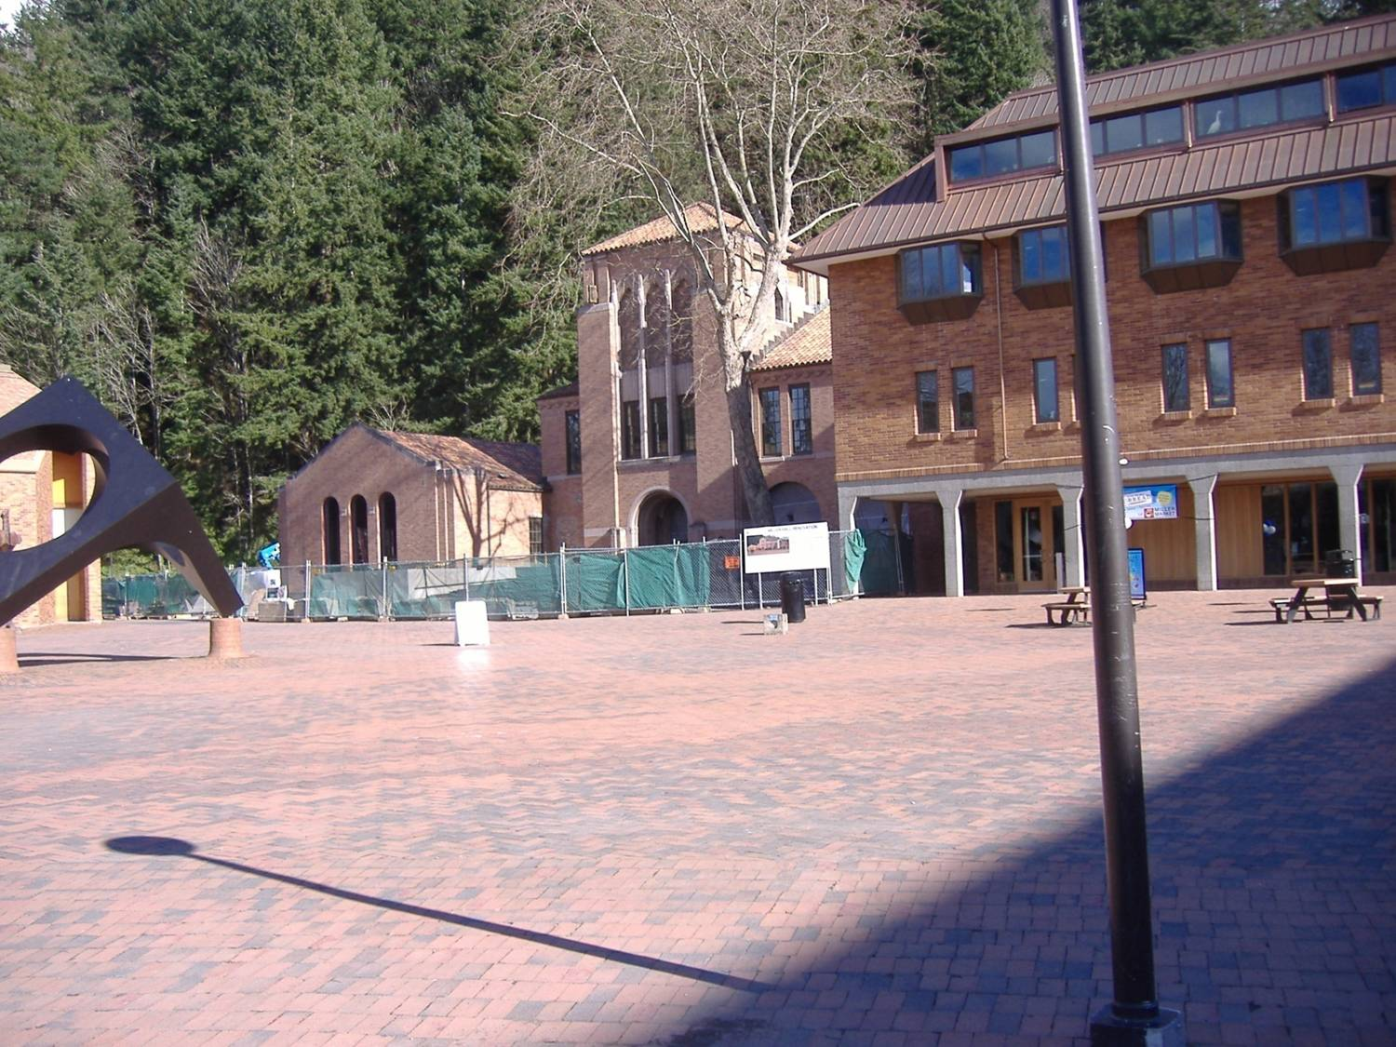

Slide 4
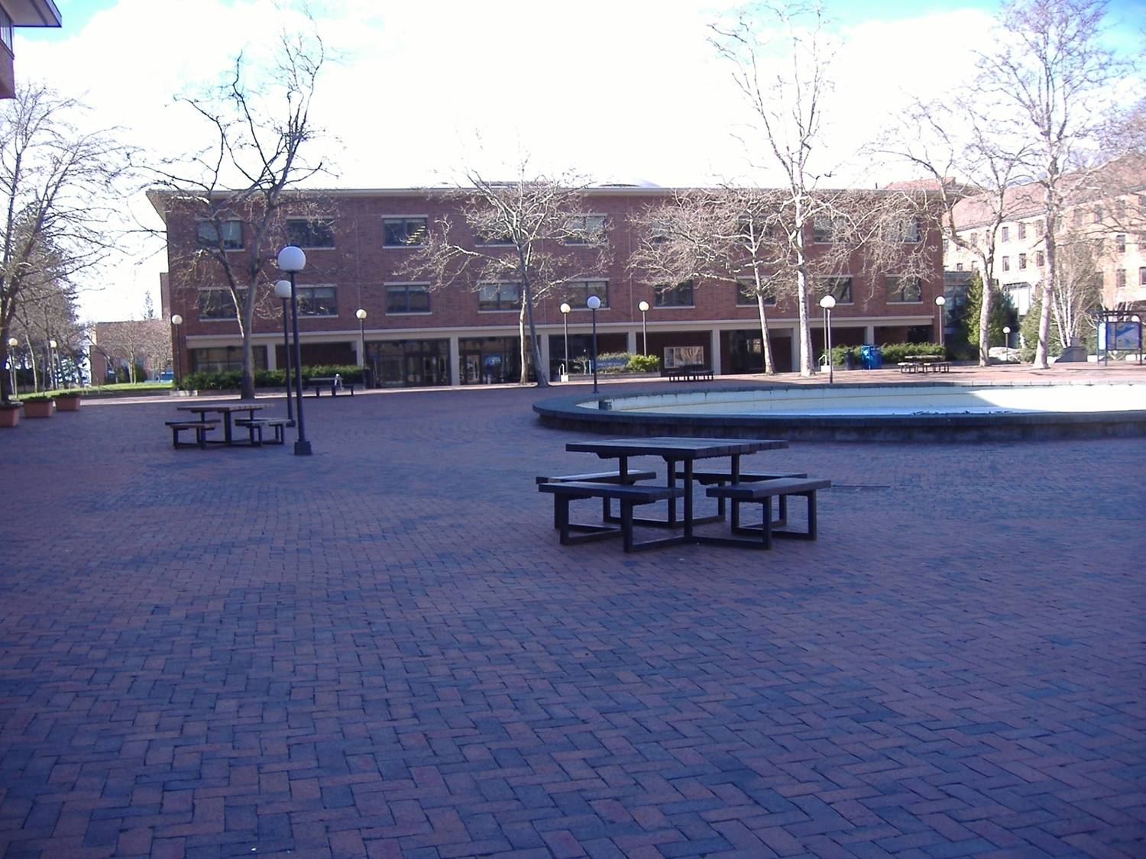

Slide 5
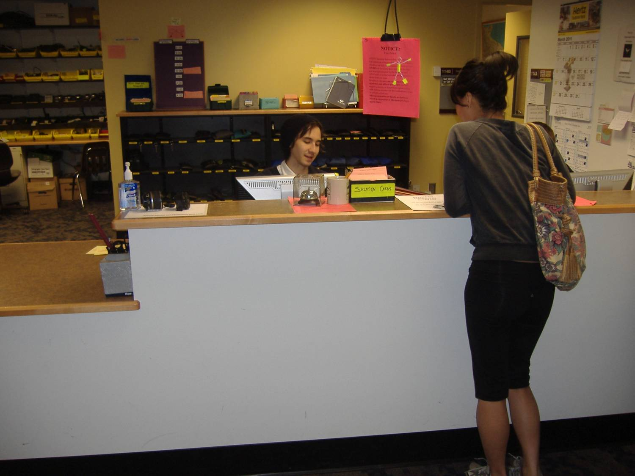

Slide 7
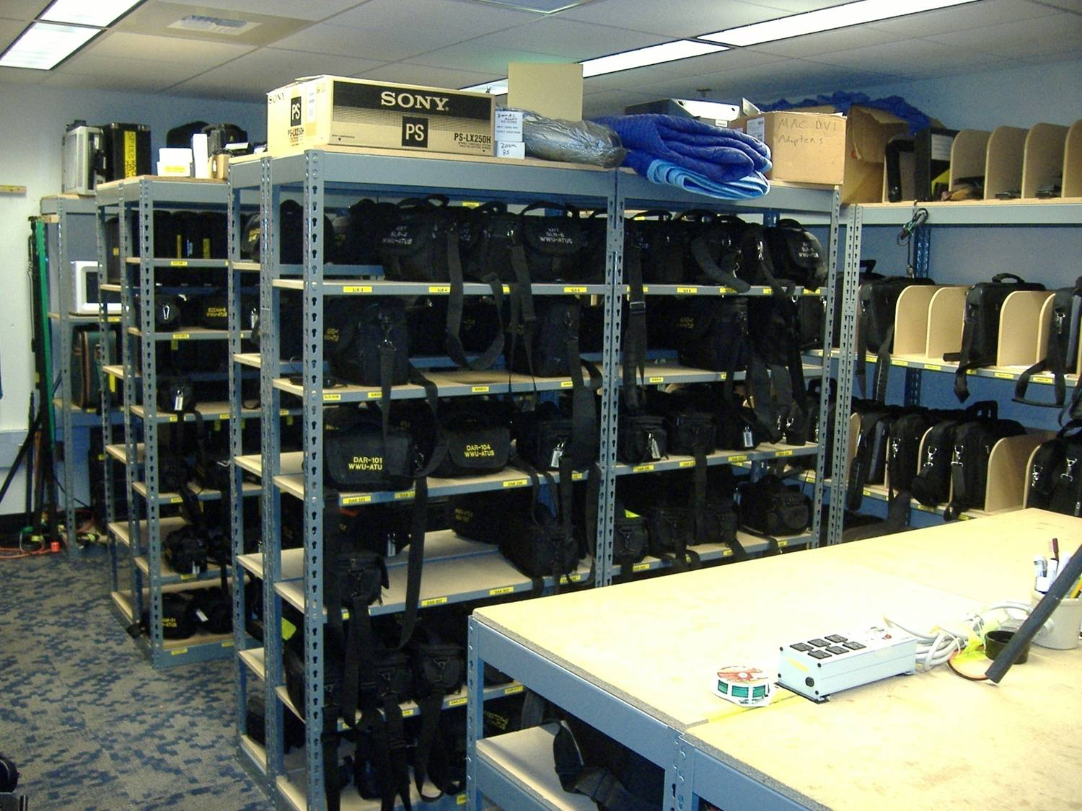

Slide 8
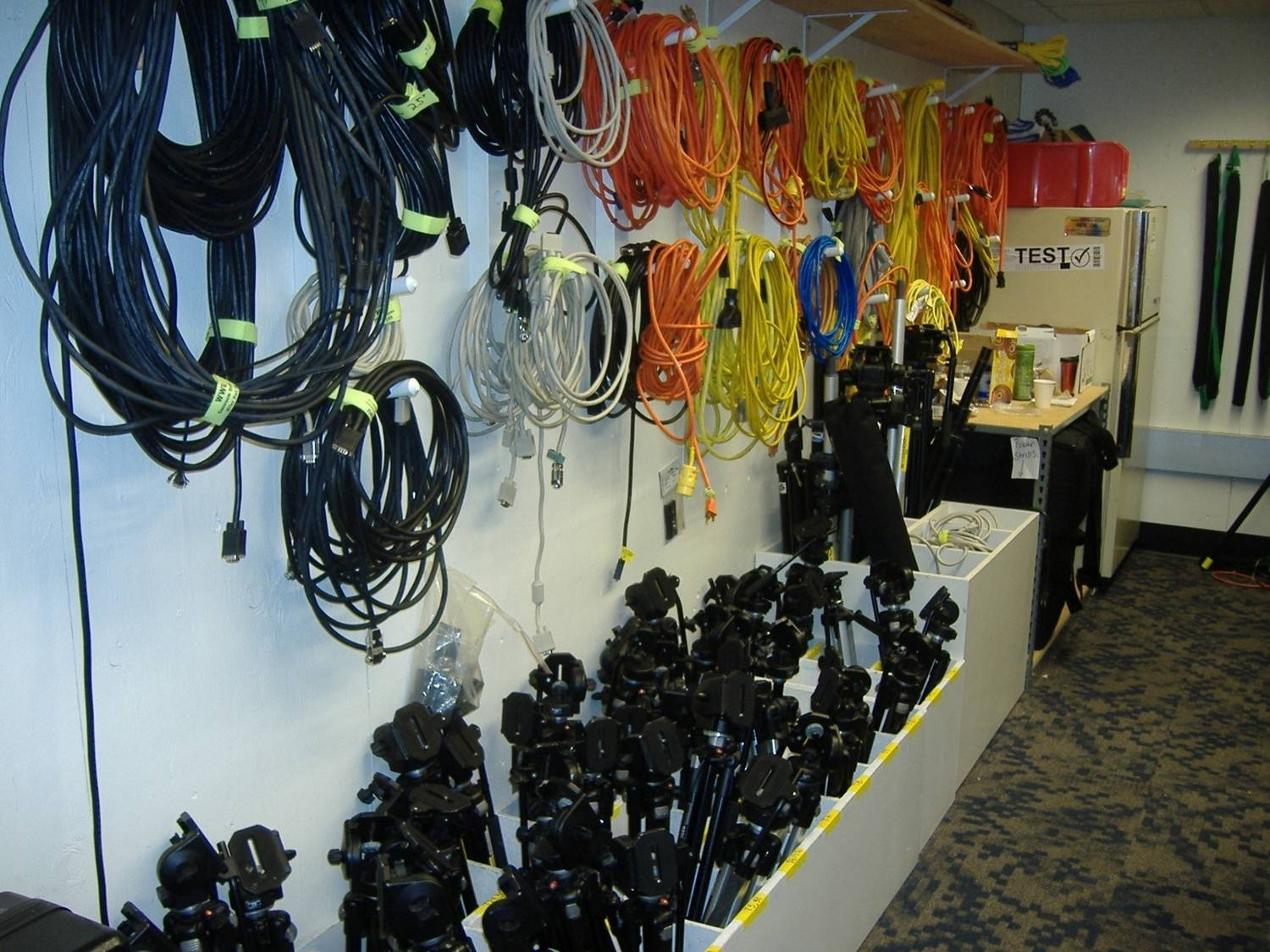

Slide 9
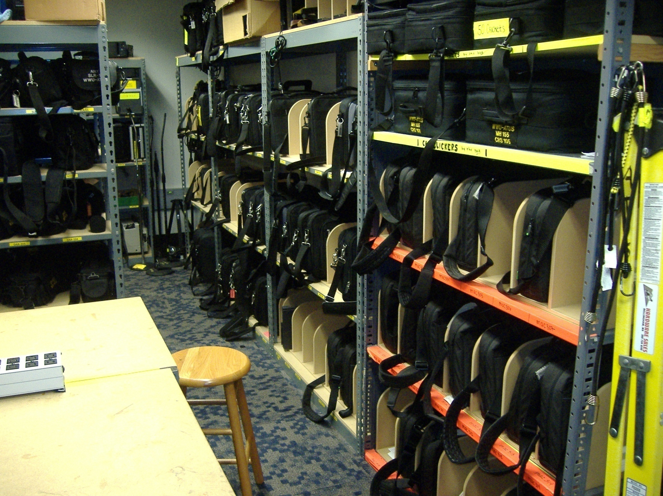

Slide 10
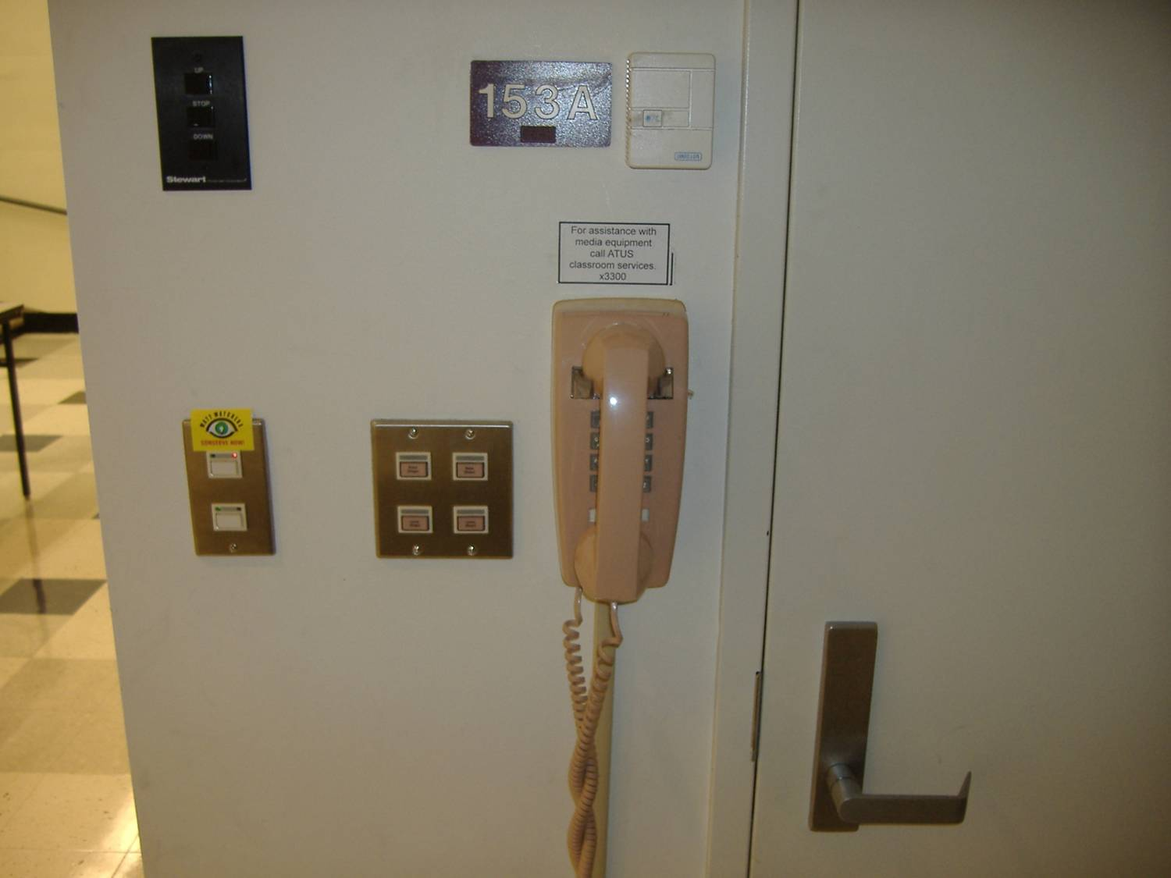

Slide 11
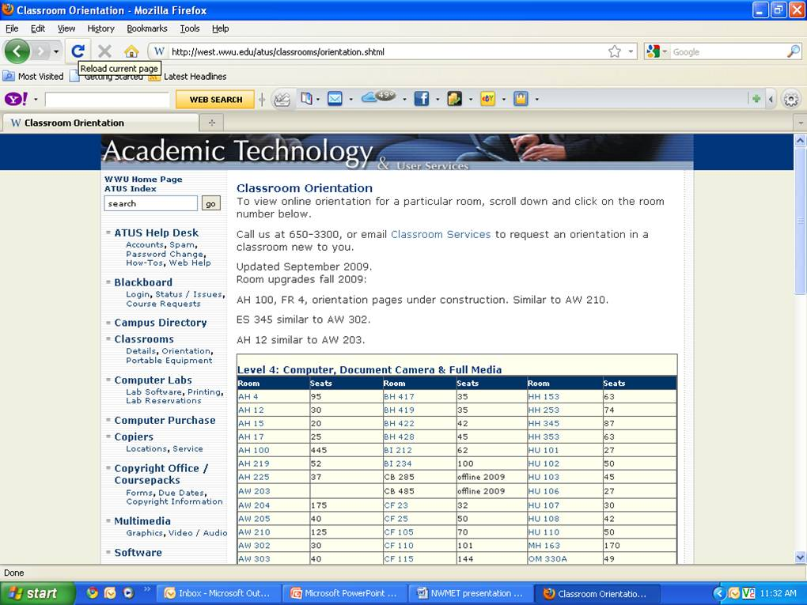

Slide 12
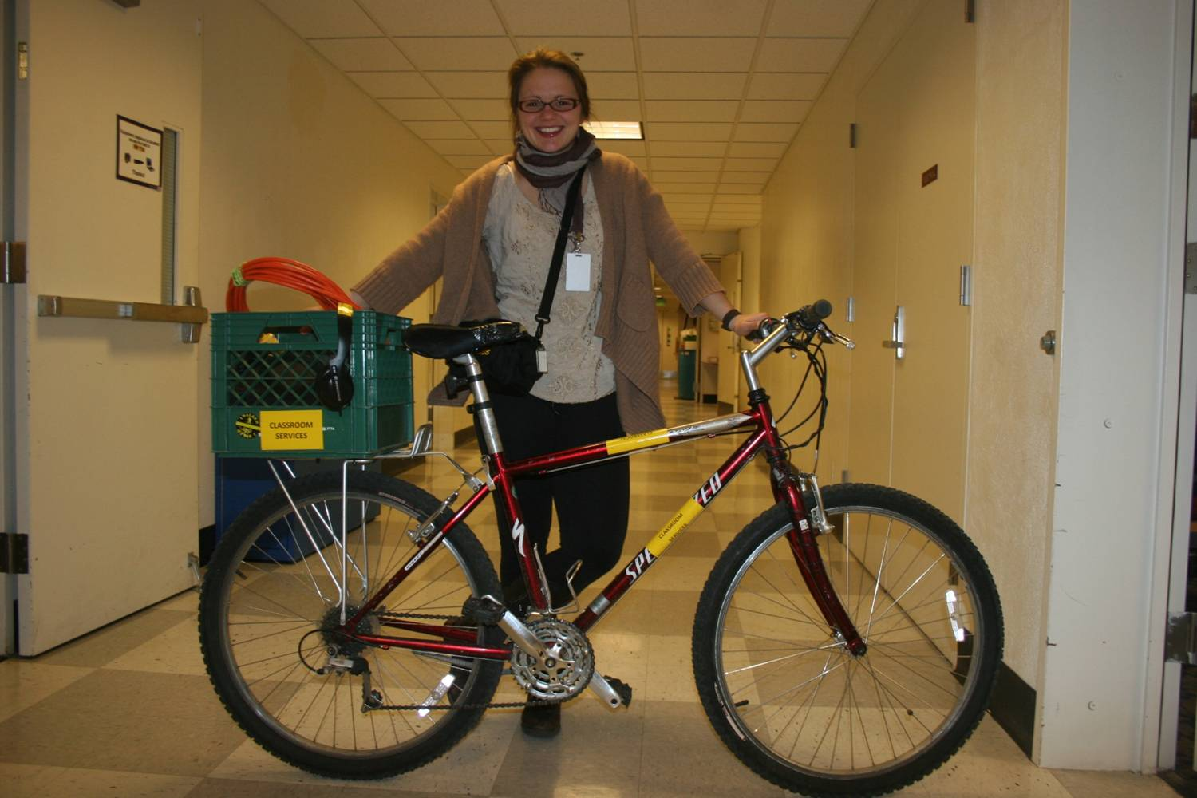

Slide 13
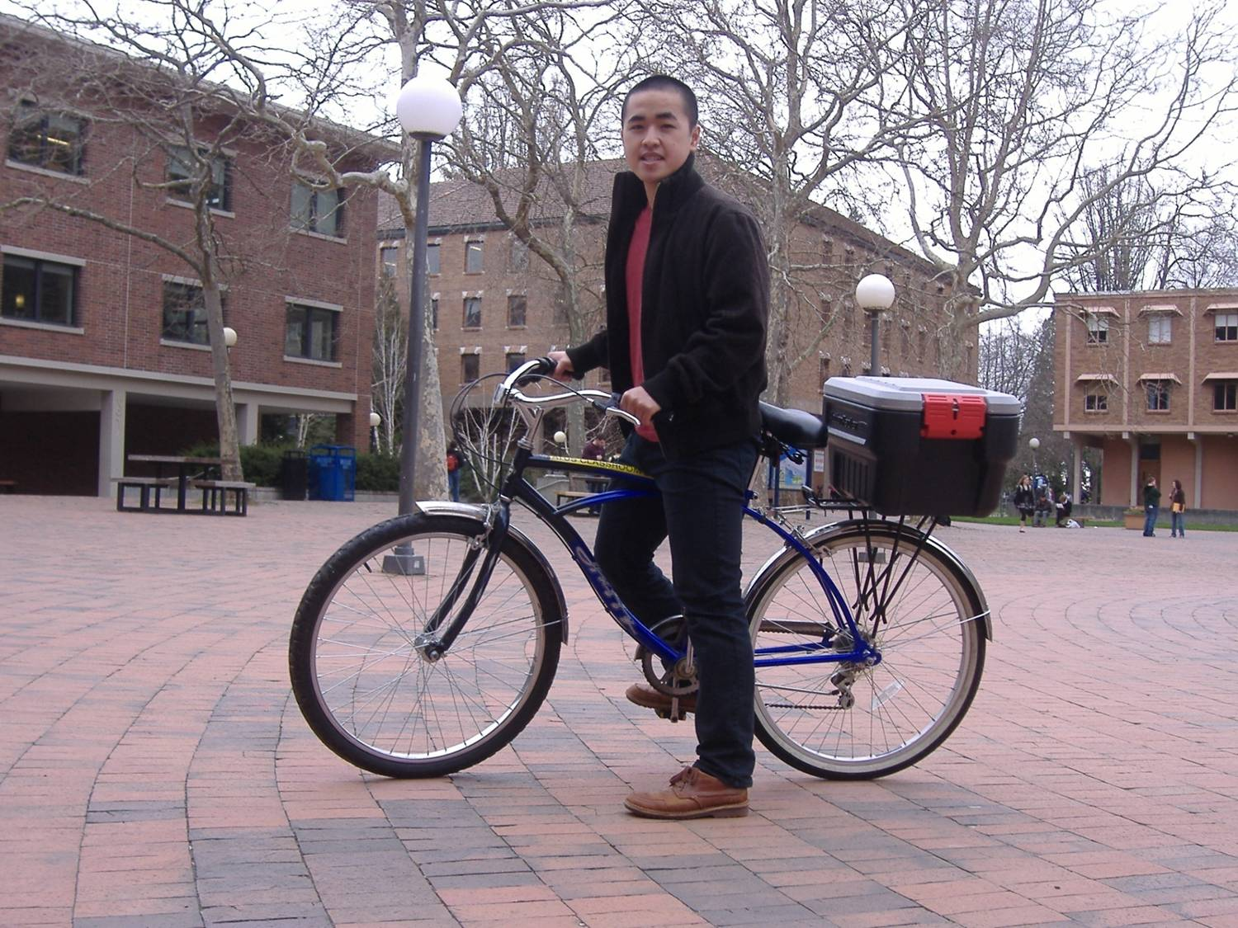

Slide 14
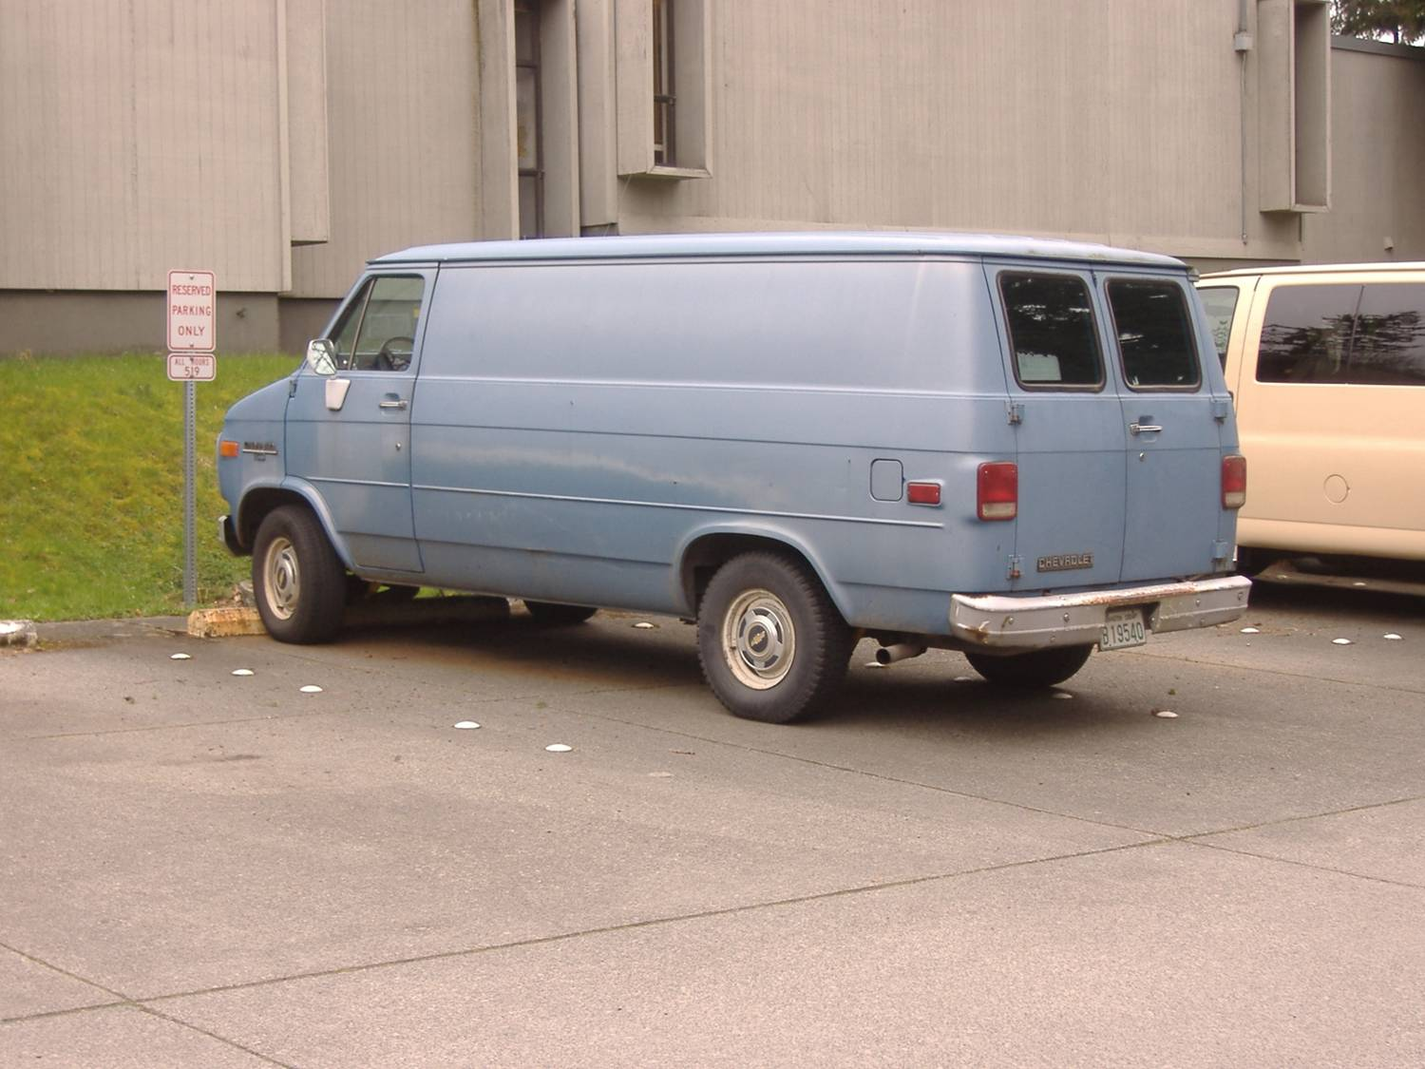

Slide 15
Prime parking spot

Slide 16
When it is raining

Slide 17
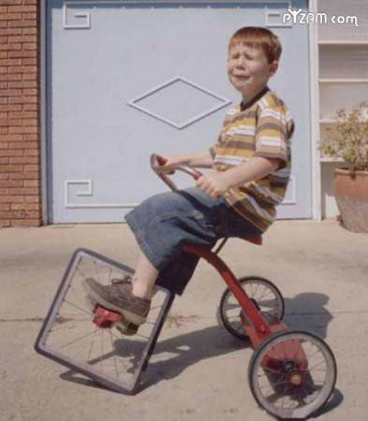

Slide 18
Treasure Hunt …..

Slide 19
Treasure chest…..

Slide 20
How to convert to this!!

Slide 21
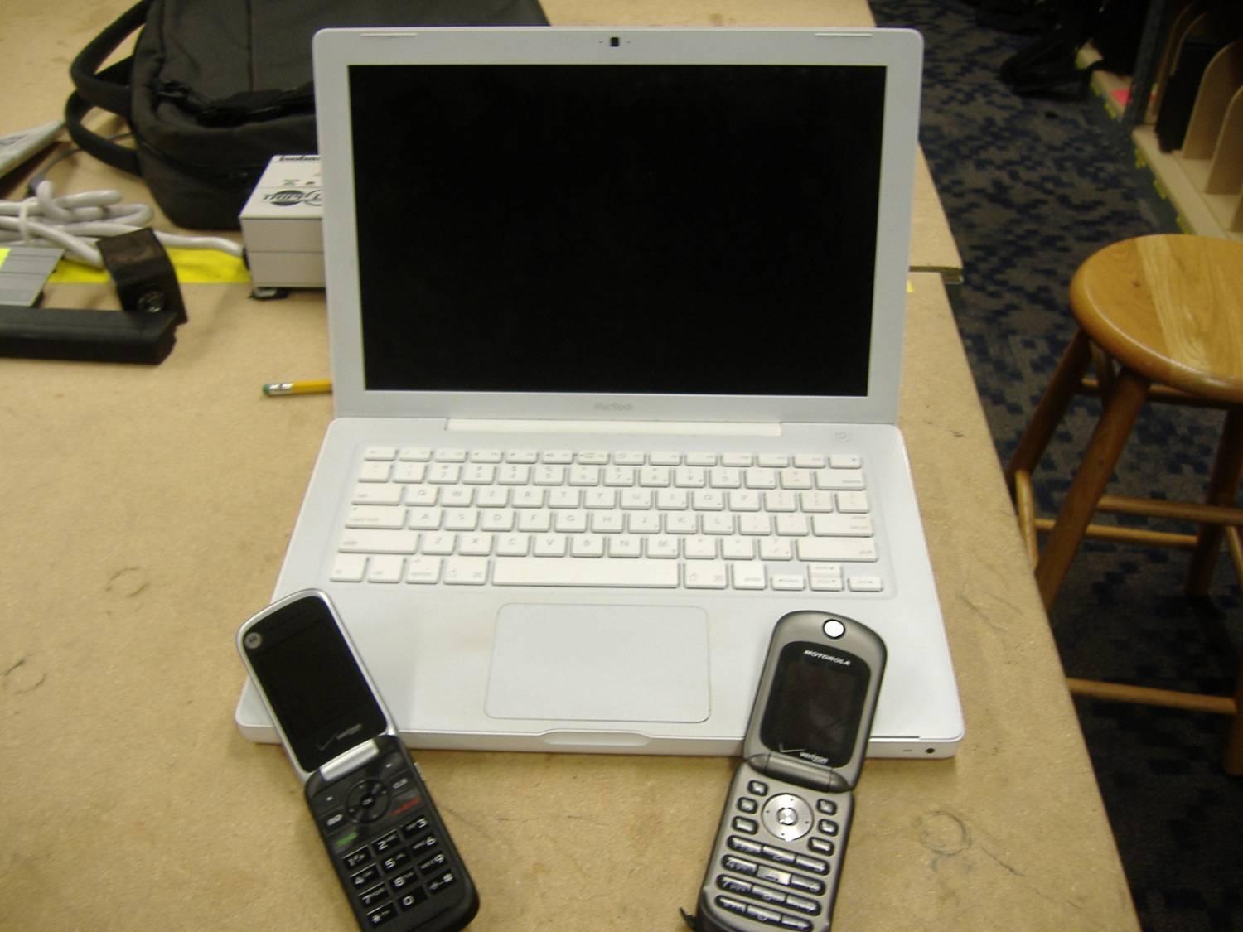

Slide 22
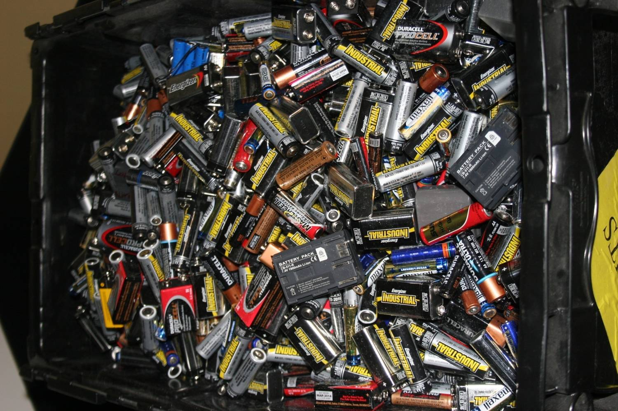

Slide 23
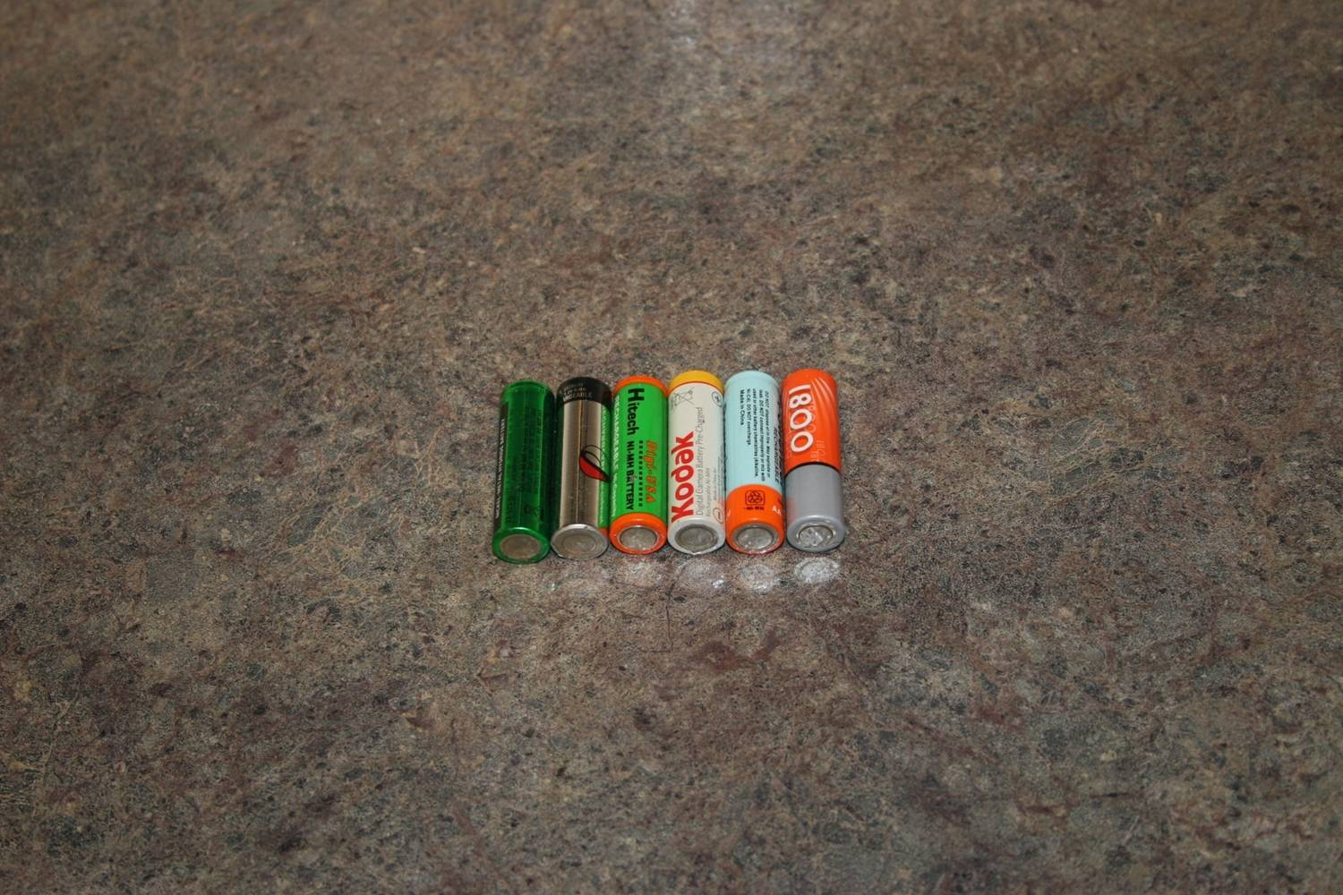

Slide 24
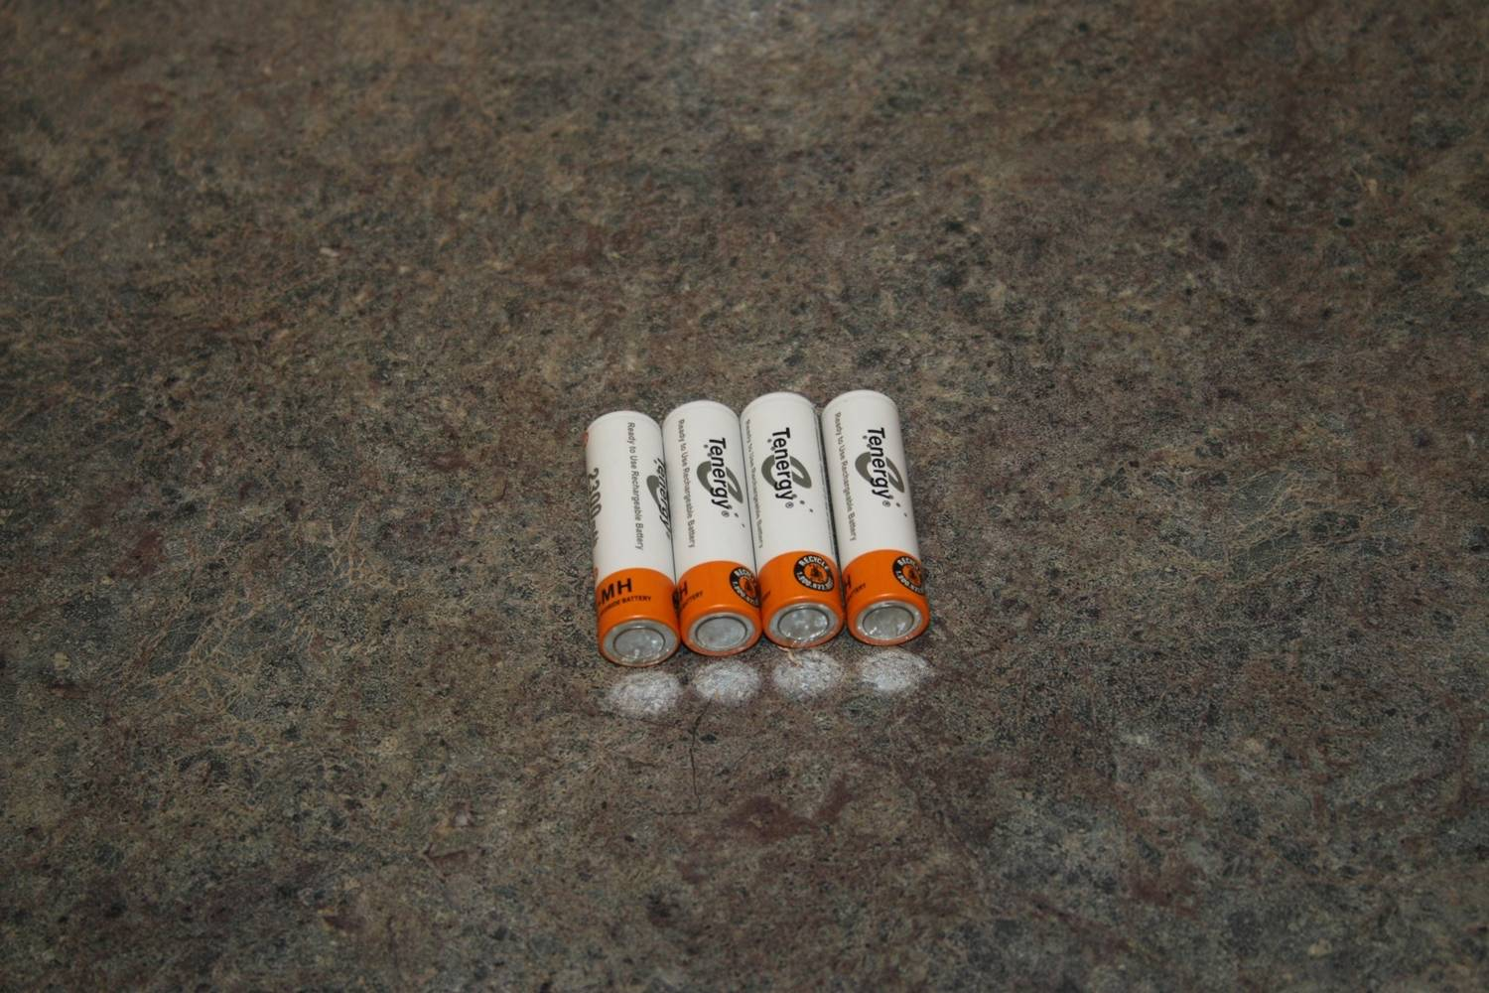

Slide 25
Latest Claims …..
Features: No memory effect Reliable service life Long-Lasting Performance Recharges up to 1000 Cycles Saves you hundreds of dollars
Note: These Batteries come pre-charged, and can maintain 85% of their charge even after a year in storage or standby.

Slide 26
Chargers.. Get what you pay for

Slide 27
Specs to look for
Features: Charges 1 - 8 pieces of size AAA and AA Battery LCD Display - 8 Respective LCD Indicators Showing Charging Status Short Circuit Protection Discharge Function allows you to refresh batteries before charging Identifies Defective Cells Intelligent microprocessor controlled. Negative delta V (- delta V) cut-off function. Reverse Polarity Protection Safety Timer - Prevents Batteries from Over Charging

Slide 28
Wireless mics….

Slide 29
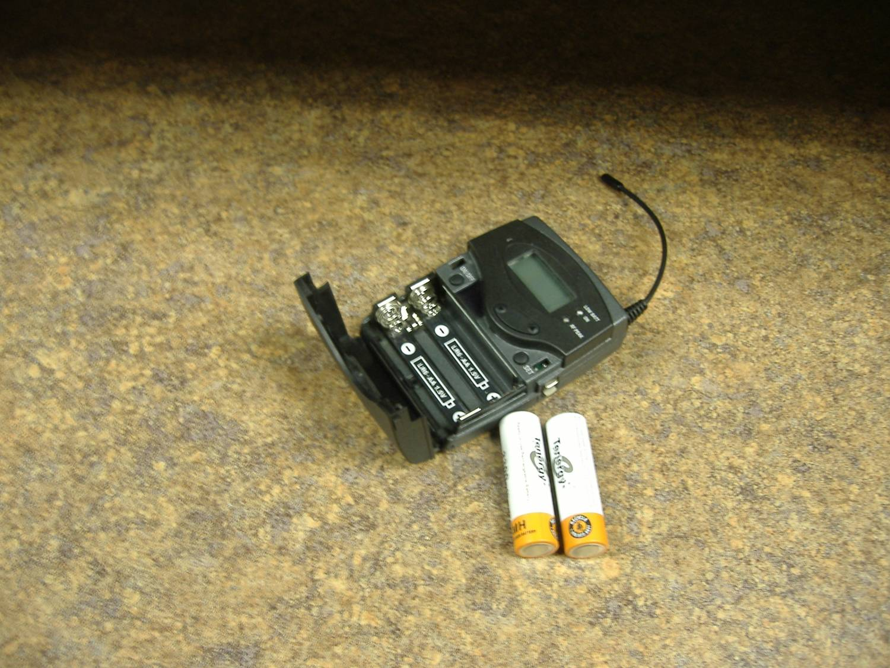

Slide 30
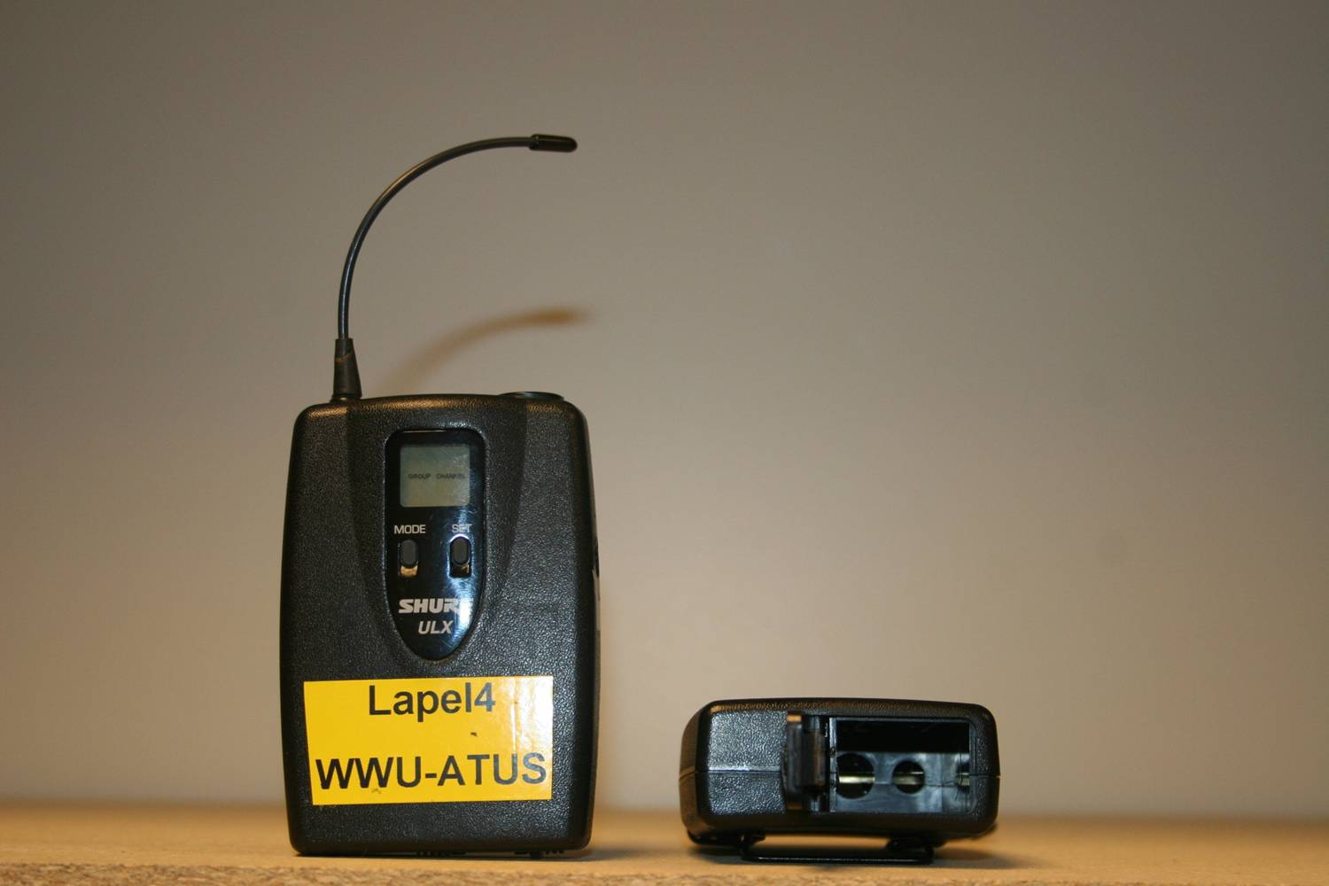

Slide 31
9 Volt battery Specs.
Standard Alkaline (non rechargable)
9.6 volts 980ma
NiCad- 7.2 volts @ 150 ma maximum
Nimh- 8.4 volts @ 250 ma (larger size)
Lith ion - 9 volt @ 500 ma-600ma (claimed)
Lithium Polymer -high 8s and 520ma

Slide 32
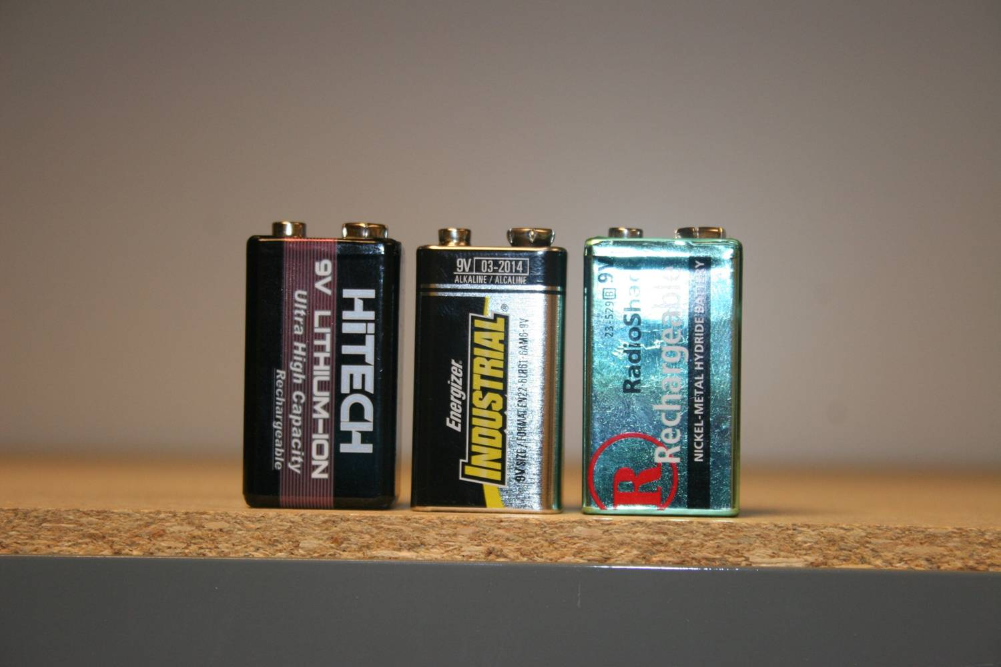

Slide 33
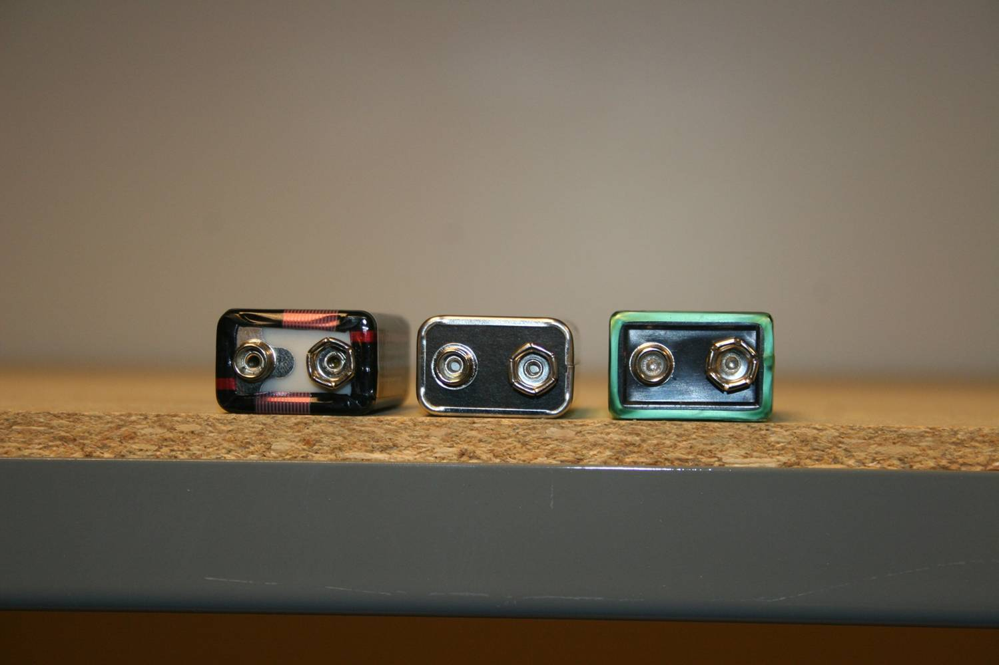

Slide 34
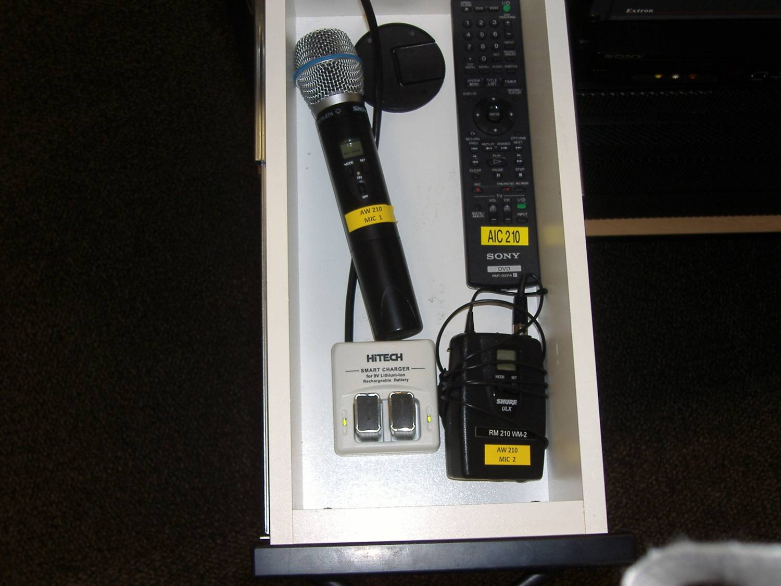

Slide 35
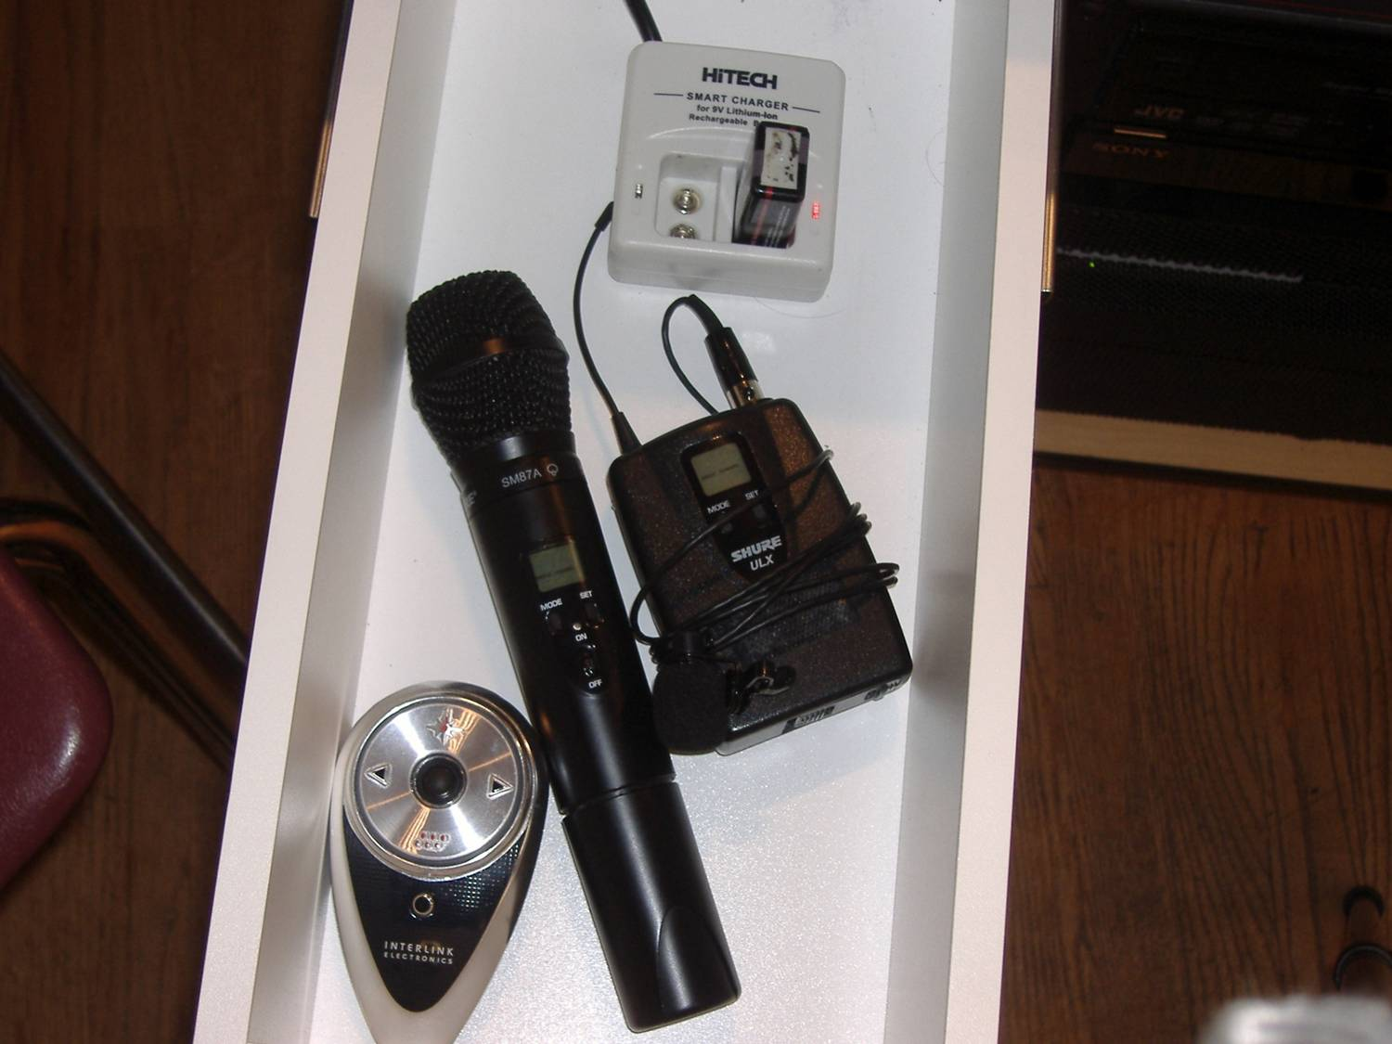

Slide 36
User training
Expect lower readings on Battery charge indicator..
Use battery until end
Don’t throw away rechargeables !!!!
Don’t recharge Alkaline battery
Signage!!!!!!!

Slide 37
Recommended suppliers
Megabatteries.com
Ipowerus.com
Great learning site: http://batteryuniversity.com/learn/

