Slide 1
Connecting the Dots: Open and Access
Northwest Managers of Educational Technology, April 18, 2018
This presentation by Amy Hofer for Open Oregon Educational Resources is adapted from Open Textbooks: Access, Affordability, and Academic Success by Dave Ernst, Open Textbook Network, and is licensed under a Creative Commons Attribution 4.0 international license. Some materials used have more restrictive licenses. Please note those licenses when you use my presentation.

Slide 2
Notes:
Logo donated by Lane Community College. Mission statement: Open Oregon Educational Resources promotes textbook affordability for community college students and facilitates widespread adoption of open, low-cost, high-quality materials.
openoregon.org website.

Slide 3
“…higher education shall be equally accessible to all…”

Slide 4
The Problem:

Slide 5
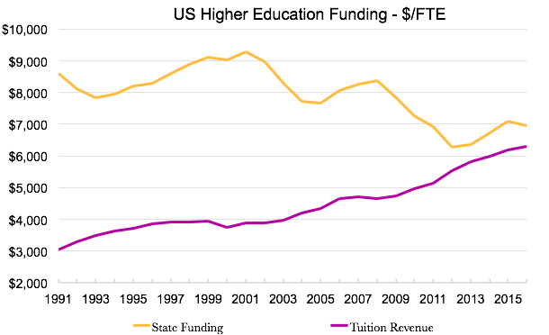
http://www.sheeo.org
Notes:
Compare the proportion of cost that students must contribute in 1989 to today.

Slide 6
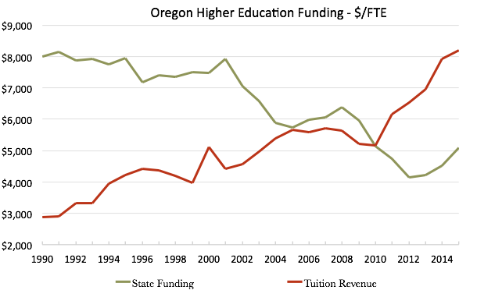
http://www.sheeo.org
Notes:
Graph of state where presentation is being made. Data can be found at http://www.sheeo.org.

Slide 7
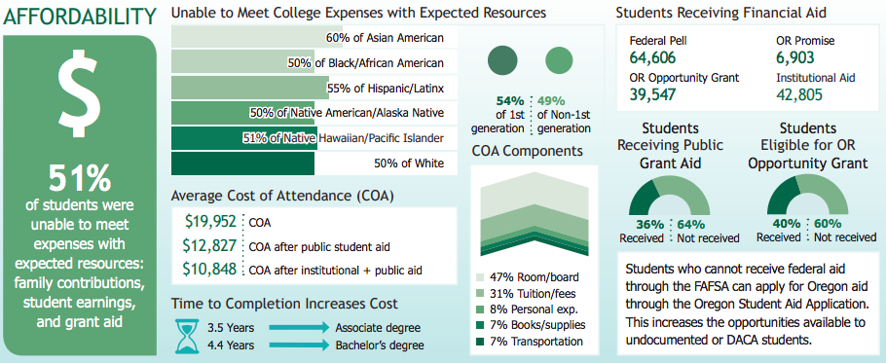
Statewide Public Institutions Affordability Snapshot
http://www.oregon.gov/highered/research/Documents/Snapshots/Statewide-Snapshot.pdf

Slide 8
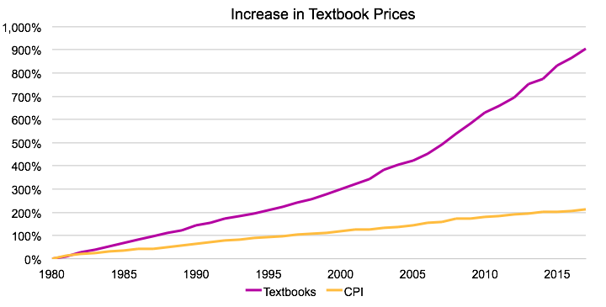
Bureau of Labor Statistics http://www.bls.gov/cpi/

Slide 9
In your academic career, has the cost of required textbooks caused you to:
2012 | 2016
63.6% | 66.5% | Not purchase the required textbook
49.2% | 47.6% | Take fewer courses
45.1% | 45.5% | Not register for a specific course
33.9% | 37.6% | Earn a poor grade
26.7% | 26.1% | Drop a course
17.0% | 19.8% | Fail a course
http://www.openaccesstextbooks.org/pdf/2012_Florida_Student_Textbook_Survey.pdf

Slide 10
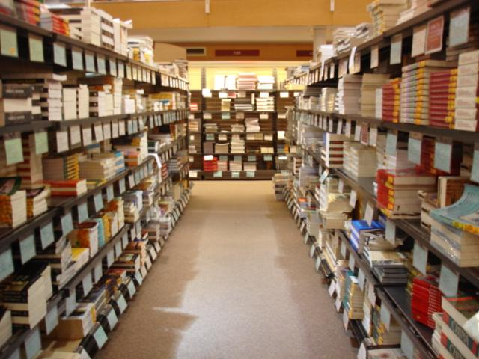
"stanford_bookstore_4-06" by Min Liu is licensed under CC BY-NC-ND 4.0

Slide 11
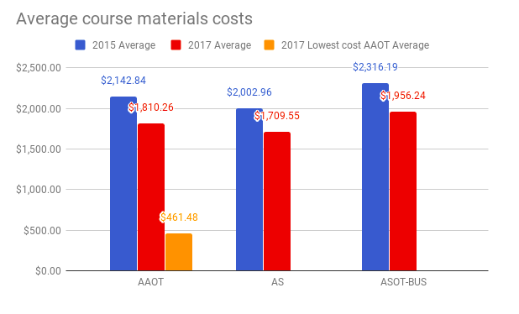
Transfer degree materials costs are down statewide
http://openoregon.org/two-years-and-a-big-difference/

Slide 12
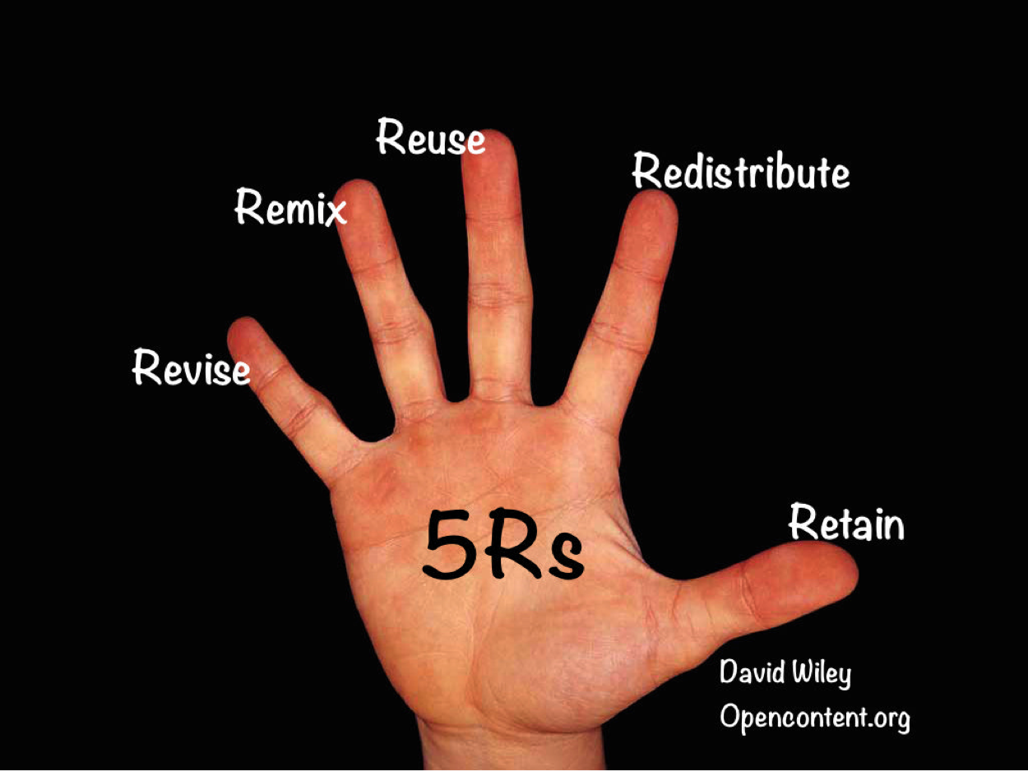
“Hand” by Golan Levin is CC-BY 2.0 Modified by Quill West, CC-BY 4.0

Slide 13
Notes:
Open content has the potential to spark innovation in accessibility, pedagogy, and course design.

Slide 14
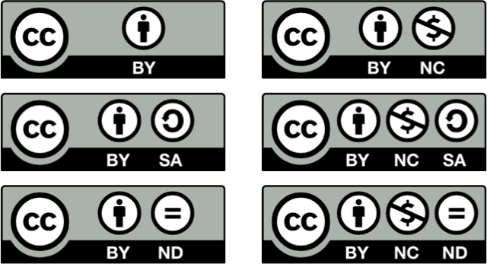
Notes:
These licenses seem to say what you can’t do when you look at them all together like this, but keep in mind that the bigger takeaway is what you CAN do with CC licensed content.

Slide 15
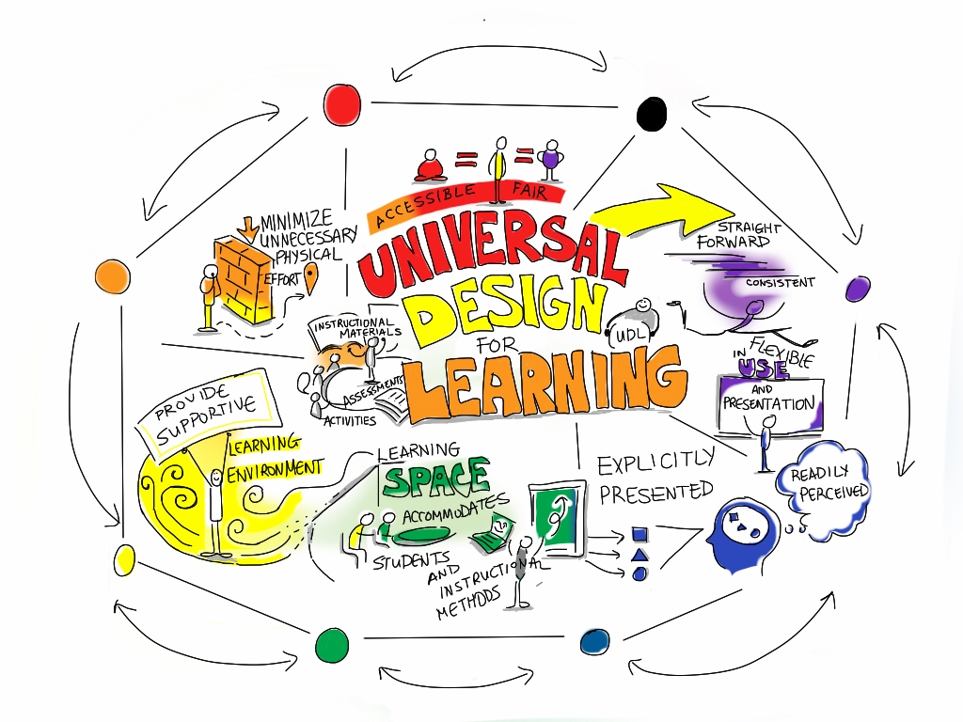
"Universal Design For Learning" by Giulia Forsythe is in the Public Domain

Slide 16
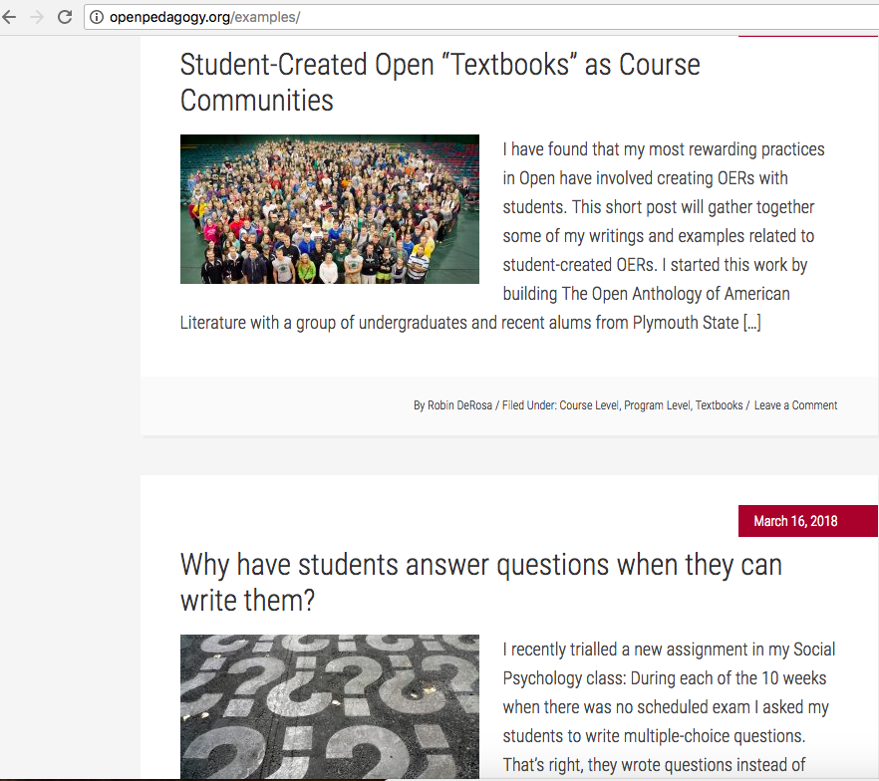

Slide 17
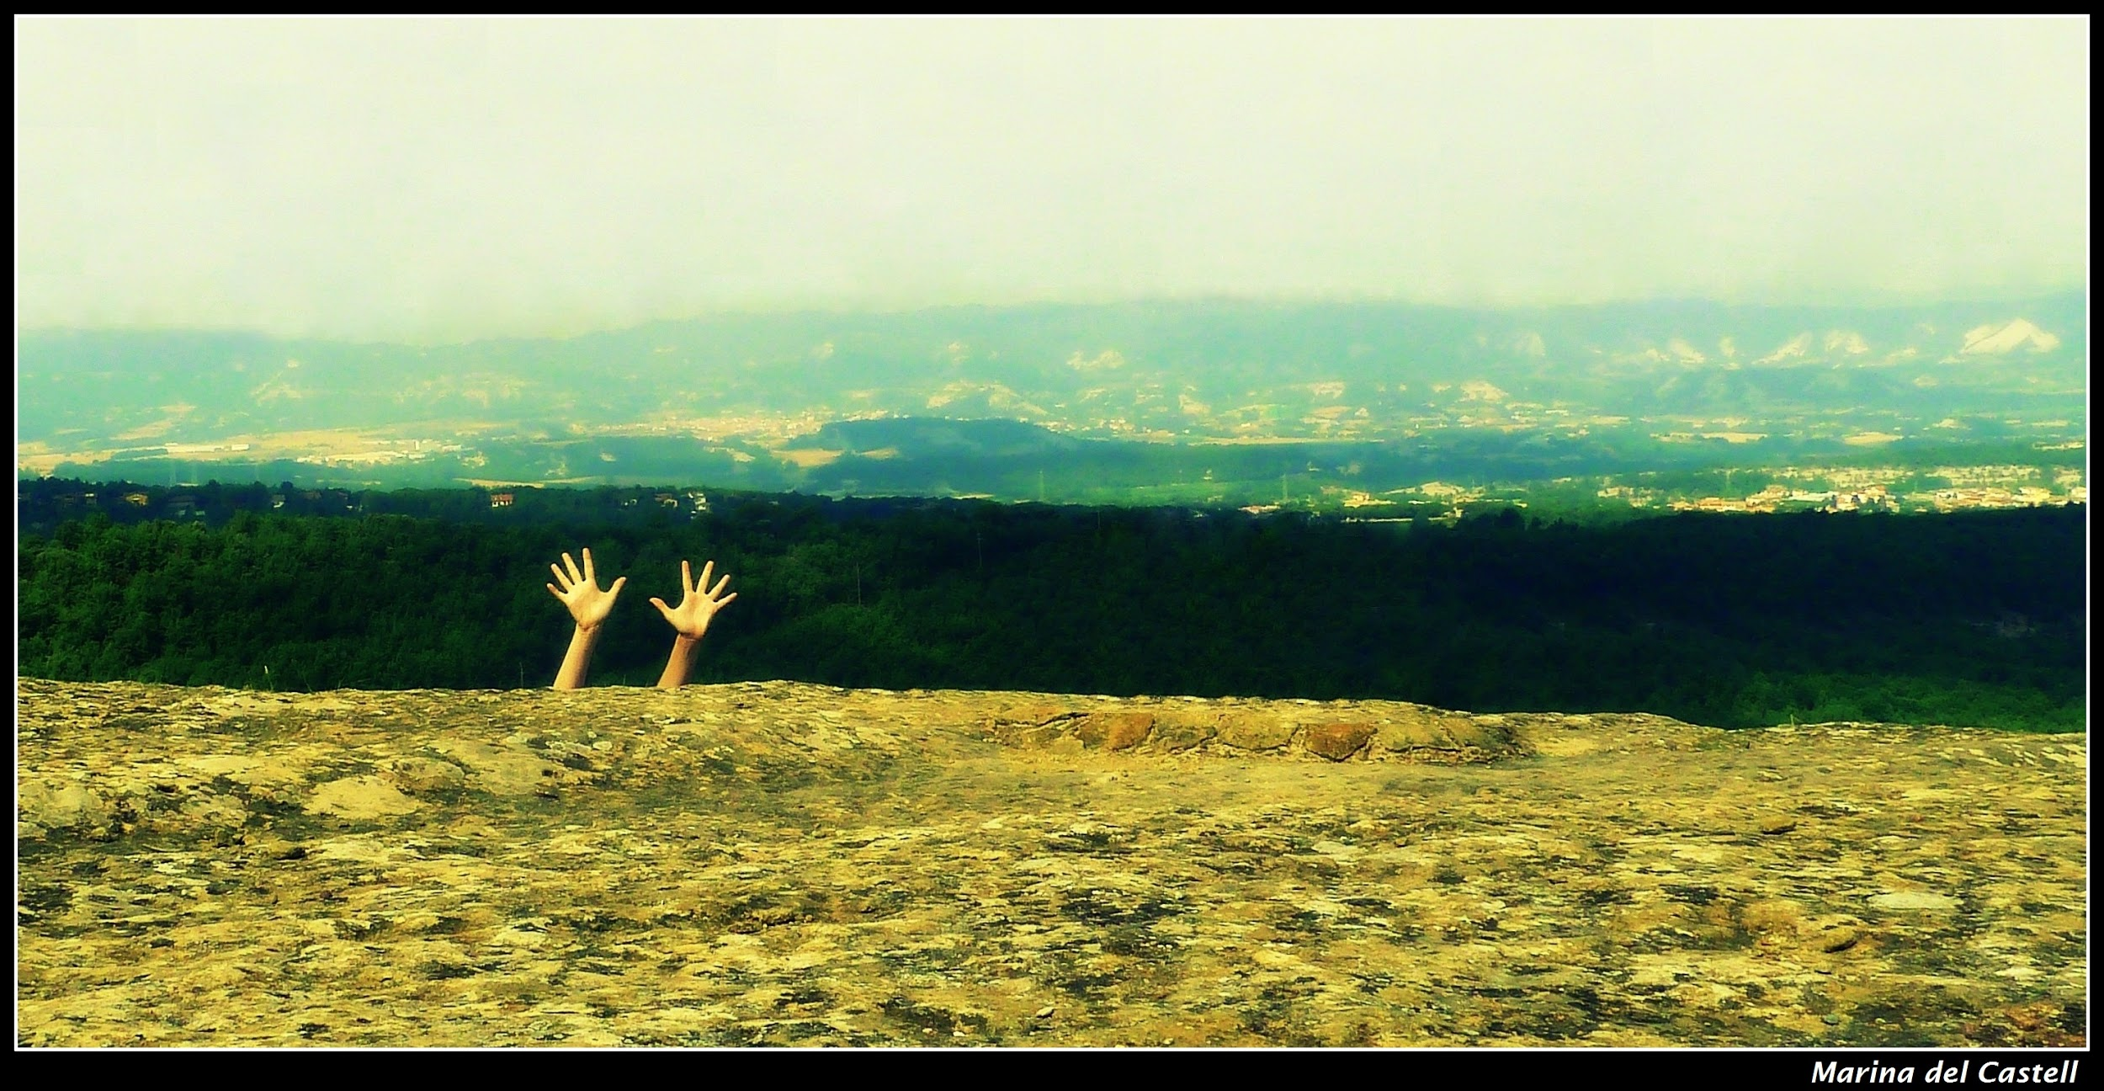
"The Help" by Marina del Castell is licensed under CC BY 4.0
Notes:
So, we’re telling faculty that they can do all these great things with OER. But where are you going to put your stuff? How are you going to use the affordance of the open license to edit someone else’s work? How will you share your work, especially if it’s interactive?

Slide 18
Questions...
Where do you see the connections between educational technology and open content?
What do you think faculty should know about ed tech when they use OER?
Are you using OER or open licenses in your own work?

Slide 19
Website: openoregon.org Twitter: @open_oregon
hofera@linnbenton.edu
"What?" by Véronique Debord-Lazaro is licensed under CC BY SA 2.0

