Slide 1
Clark College eLearning
Migration to
Moodlerooms Joule
Cynthia Foreman, Associate Director of eLearning
Scott Coffie, eLearning Systems Administrator

Slide 2
Background
Fall 2008: SBCTC initiated statewide LMS contract, WAOL and several individual Colleges move to ANGEL.
Spring 2009: Clark College signed a one year contract with Blackboard with the intent of considering a possible change to an open source LMS to cut costs and add features without harming the rapidly growing eLearning program.
Fall 2009: Subcommittee of the eLearning Committee researched and reviewed the open source LMS options for Clark College that would be secure, robust, and scalable.
After considering the recommendations of the eLearning subcommittee, the Executive Cabinet elected to move forward on the cost saving path offered by the Moodlerooms Joule.

Slide 3
Why change the LMS?
Main considerations driving the change in LMS:
Need to be more fiscally responsible during tough economic times and severe budget cuts.
Potential to reduce eLearning fees paid by students to help counter ever increasing costs to students.
Unable to remain with current version of Blackboard. Upgraded version would require faculty retraining and course conversion.
Potential for delivering additional features and services without added overall cost.

Slide 4
Increasing LMS Usage = Increased Demand for Student & Faculty Technical Support
 | Hybrid Sections | Online Sections | Face-to-Face Web-enhanced Sections | Active Users
Fall 2009 | 28 | 142 | 381 | 8452
Fall 2010 | 38 | 159 | 440 | 9515
Increase | + 36% | + 12% | + 15% | + 13%
LMS usage campus-wide, not just eLearning
Over 60% of Clark College students using LMS

Slide 5
Annual eLearning Cost Breakdown with Blackboard as the LMS:

Slide 6
Identifying New LMS
Five LMS solutions were identified as sufficiently robust, secure, and scalable to meet the needs of Clark College. These included three proprietary solutions: Blackboard, eCollege, and Desire2Learn, plus two open source solutions: Sakai and Moodle.
Fiscal considerations ruled out proprietary options. Sakai and Moodle identified as the two open source LMS options sufficiently robust to serve the needs of Clark College.
Hosting organizations for both Sakai and Moodle invited to Clark College to conduct informational sessions and hands-on demonstrations.

Slide 7
Campus-wide Process
Driven by eLearning Committee: faculty, staff, students & administrators
Transparent process: email, blog, open sessions, video streaming
Feedback loop
Reasons for selecting Moodle over Sakai:
  Significant cost savings
  Superior technical support and customer service from Moodlerooms
  Better ADA compliance
  Unlimited file storage – Cloud

Slide 8
 | Moodlerooms Joule | Blackboard
1 year licensing & hosting | $80,000 | $185,000
Sufficient file storage for 10,000 users | Included | $34,000
Content/File management system | Included | $72,000
ePortfolio | Included | Unknown
Equella online educational resource repository | Included | Unknown

Slide 9
Exciting New LMS Features
$ 15/year
ePortfolio
Equella
Digital Repository
LMS
Moodlerooms Joule
Joule Mobile
SMS
Conduit

Slide 10
Joule Features
Conduit – integration piece linking SMS to LMS
Migration Tools
E-Portfolio
Digital Repository
Integration with other web tools: Turnitin, Elluminate, Wimba, Tegrity, Respondus
24/7 Support - Perceptis

Slide 11
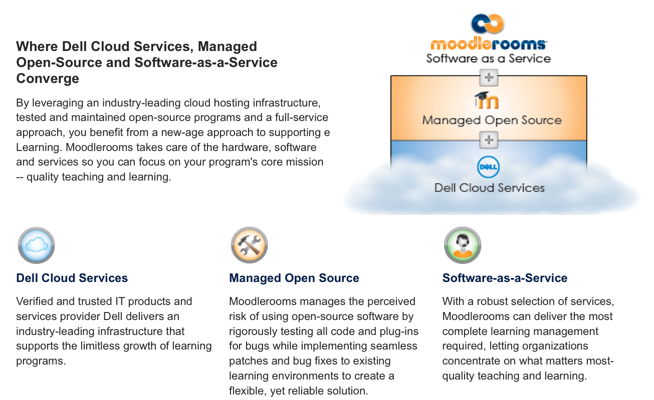
Managed Open Source

Slide 12
Month | Activity
April 2010 | Sign one year contract with Blackboard from July 1, 2010, through June 30, 2011. Arrange managed open source vendor presentations, research and consult with other institutions that have completed a similar change in LMS.
April – May 2010 | Open source managed hosting vendor presentations to college community; open forums, hands-on labs, panel discussions and feedback opportunities.
May 2010 | Selection of new LMS project supporting fiscal responsibility initiatives.
July 2010 - June 2011 | Run dual platform throughout the academic year, migrating courses over gradually.
Summer 2010 | Training for eLearning staff and pilot group. Implementation of new LMS begins.
Fall 2010 | Informational sessions for faculty, students, and staff. Hands-on training for online/hybrid faculty only; course migration begins. Pilot group begins instruction in new LMS with ongoing evaluation, adjustment, and critique.
Winter 2011 | 1st block of eLearning courses migrated to new LMS. Additional training provided for F2F and new faculty. Project numbers/feedback analysis.
Spring 2011 | 2nd block of courses migrated; continuation of faculty training.
Summer 2011 | Migration project finalized. Training moves to sustained model.

Slide 13
Migration to Moodlerooms Joule
Summer 2010 Pilot – 11 instructors and eLearning department in training
Fall 2010 – training for eLearning faculty – approximately 135 Online and Hybrid Instructors identified for training
Moodle Pilot – 6 Instructors; 9 courses; 200 students
Winter & Spring 2011 – training for rest of faculty-
  200 to 300 additional instructors
Summer 2011 – fully migrated

Slide 14
Course Migration
Macroeconomics Online Course in Blackboard version 7.3
Macroeconomics course conversion
Macroeconomics course in Moodlerooms Joule

Slide 15
Number of Faculty Trained

Slide 17
Meeting Migration Challenges
Staffing during migration
  Additional part-time faculty trainer
  Additional technical support to handle data integration and management of two LMS
Maintaining department morale
  Exceptional Classified Staff Award for Summer Quarter, Naomi Kay of eLearning
  Exceptional Classified Staff Award for Fall Quarter, Scott Coffie of eLearning

Slide 19
Student Feedback on gradual implementation
I had one class on Moodle and one still on Blackboard...this was very difficult and frustrating at times...this should have been prevented as a possibility. 3/12/11 10:05PM
I was dismayed to discover that my English class would be on Blackboard, and my Math class would be on Moodle this quarter. I knew that this would be both annoying and confusing, and distract from the learning process. While I found Moodle to be effective, easy to use, and efficient, I was not as impressed with Blackboard, having to spend long amounts of time wandering around the site trying to find the information I needed and wishing that both my classes were on Moodle. In fact, I spent quite a lot of time resenting Clark for making me take two classes on two different online sites that work quite differently from each other, time which no doubt could have been better spent learning. 3/13/11 4:52AM

Slide 20
Additional Student Assistance
Student Orientations for Winter Quarter
  14 student orientations offered
  38 students attended, from 0 to 6
Student Orientations for Spring Quarter
  23 student orientations offered
  50 students attended, from 0 to 9

Slide 21
Comments from a
Winter Quarter Instructor
I just want to send out a well-done to the E-learning for choosing Moodle. As an adjunct, I have to use many different online platforms at different institutions. I have been trained, retrained, and through many mentorships. My point? Moodle is the bomb.
I have to say that Moodle is by far my favorite online platform. Easy training. It looks good. My students have minimal issues. And I mean minimal. Then there's the low costs and high efficiency. And an efficient platform makes me look good to my students. Just read my last term evaluations. Well you can't. But trust me, Moodle made me look GOOD.
At another institution, Blackboard 9.1 has been the bane of my last quarter. And, it is sadly my current pain. It makes me wonder: what did I do before Moodle.
Yes, it is just that good. And no one is paying me to say this.
So, thanks.
A grateful adjunct,

Slide 22
Thank you!
Cynthia Foreman, Associate Director of eLearning
cforeman@clark.edu
Scott Coffie, eLearning Systems Administrator
scoffie@clark.edu

