Slide 1

https://sites.google.com/site/whoactuallyrules/
While you are waiting for class to begin
Please go to this site and take
the Google Apps survey.

Slide 2
Does Google Rule the World?
Who Actually Rules the World?

Slide 3
Does Google Rule the World?
Well, in the Universe I inhabit
The world is ruled by…

Slide 4

Olivia

Slide 5
Does Google Rule the World?
Pardon me,
Being a Grandpa is so consuming, but
Back on task..

Slide 6
Does Google Rule the World?
If it’s a matter of numbers
Then it really depends on what
you are counting.

Slide 7

Does Google Rule the World?
Let’s count
Internet Browsers

Slide 8
Does Google Rule the World?
What are the top three
Internet browsers in the world?

Slide 9
Does Google Rule the World?
This is a trick question.
The trick is to look at the
three pictures at the top of the page

Slide 10

Who are these guys?
Where did they come from?
How long have they been around?
Are they short-cutted to your desktop?
What’s your guess..1, 2 or 3?

Slide 11
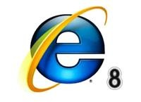
What about the face of evil?
How did they fall from grace?
Why do the Europeans hate them so much?
Have you deleted their shortcut?
What’s your guess..1, 2 or 3?

Slide 12
And now, the new kid
Where did they come from?
How long have they been around?
Are they short-cutted to your desktop?
What’s your guess..1, 2 or 3?

Slide 13
Does Google Rule the World?
The drum roll, please!
Browser Stats March 2011
Stats from another source

Slide 14
Does Google Rule the World?
Based on the data
What is the answer to the Question?

Slide 15
Does Google Rule the World?
Let’s count
Search Engines

Slide 16
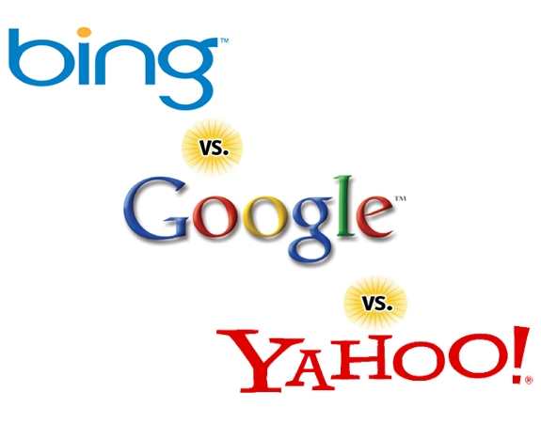

Slide 17
Does Google Rule the World?
Is Bing a contender?

Slide 18
Does Google Rule the World?
And the Answer is..

Slide 19
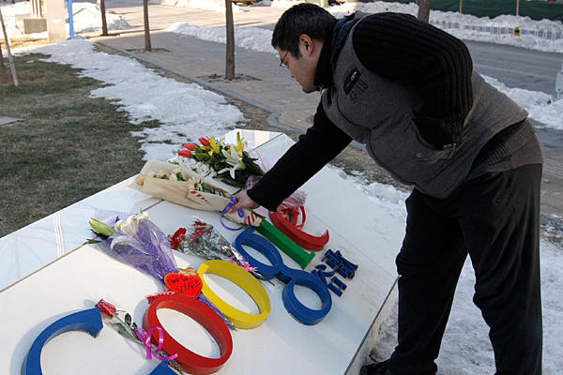
Google slipping in China
The War with China
Ratcheting up the pressure
But then with 400M users do you hang in there anyway?

