Slide 1
Standardization in Classroom Technology
Presented by Mark Walker
Technology Classrooms and Labs Manager
Portland State University
Northwest College and University Council for Management of Educational Technology

Slide 2
Overview
Learning from the Past: A History of Instructional Technology at Portland State University
Standardizing: What? When? Why?
Lessons Learned: PSU Technology Classrooms
On-Going Challenges

Slide 3
A Few Notes
Sharing PSU’s experience
Hindsight is 20/20
A disclaimer about products and bias
Questions

Slide 4
A Few Notes
PSU: Size Types and Numbers of Classrooms ITS vs. USS
My History with PSU and OIT

Slide 5
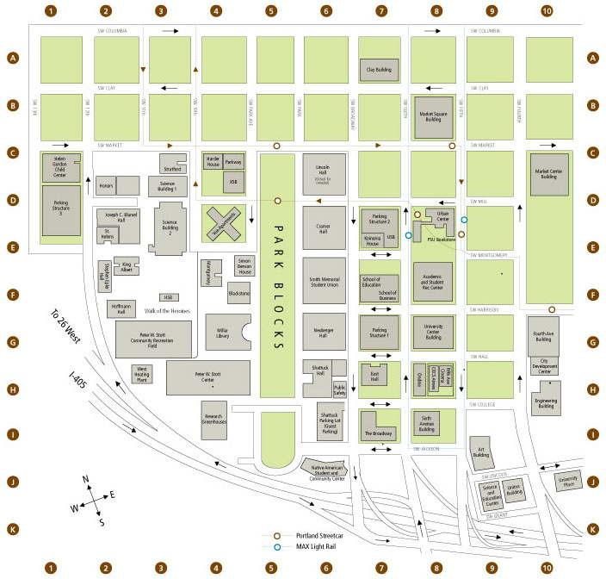
PSU Campus Map
30,000+ Students
Lots of
Adjunct Faculty

Slide 6
Section 1
Back Story: Technology Classrooms at PSU

Slide 7
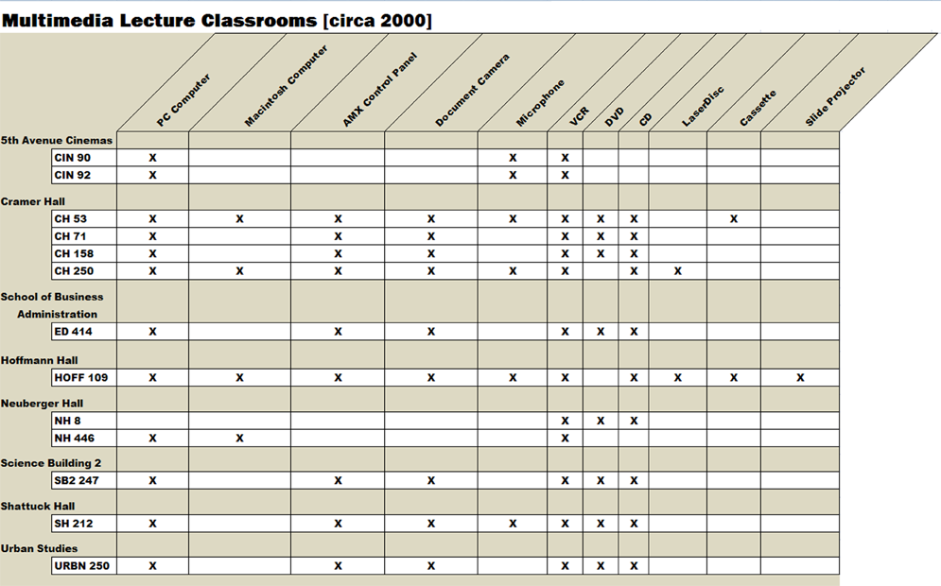
Classroom Technology (circa 2000)
13 Technology Enhanced Classrooms
Almost all technology enhanced classrooms have attributes unique to each of them
With the Ribbon, commands and other tools you need are now visible and more readily accessible.

Slide 8
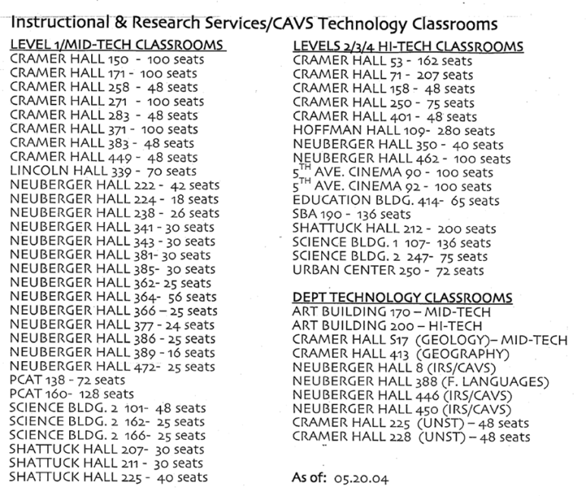
Classroom Technology (circa 2004)
31 “Mid-Tech” Classrooms
16 “High-Techs” (2 level 2s, 10 level 3s, and 4 level 4s)
10 Departmental Technology Classrooms
Tabs sit

Slide 9
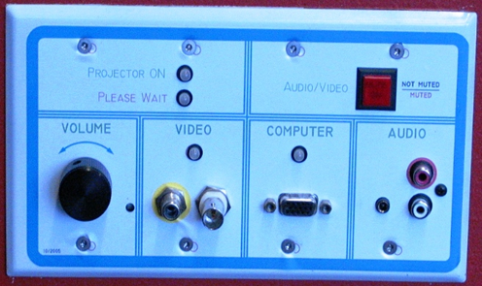
The Levels: Level 1 (The Mid-Tech)
Projector and amplifier turn on once a video signal is detected
Use of laptops, DVD, VHS players
Seems Standardized
Economical way to expand technology across campus

Slide 10
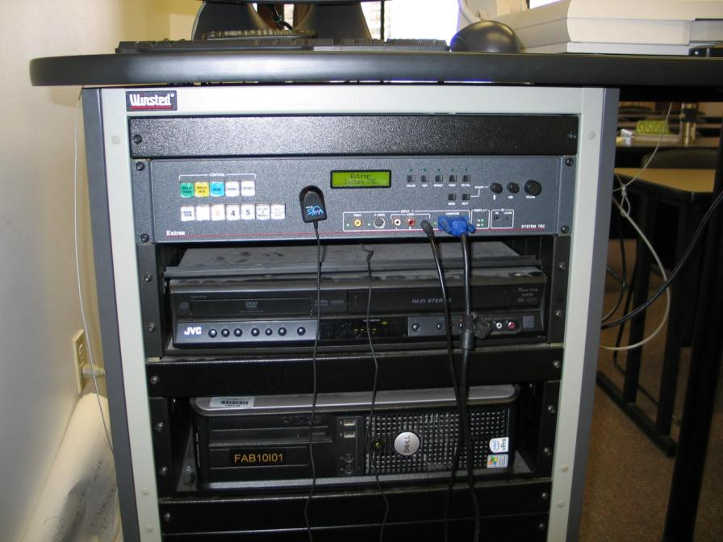
The Levels: Level 2
Extron System 7 SC
Resident PC, DVD/VCR, and (sometimes) a Document Camera
Press and hold “Display Power” for two seconds to turn off/on projector

Slide 11
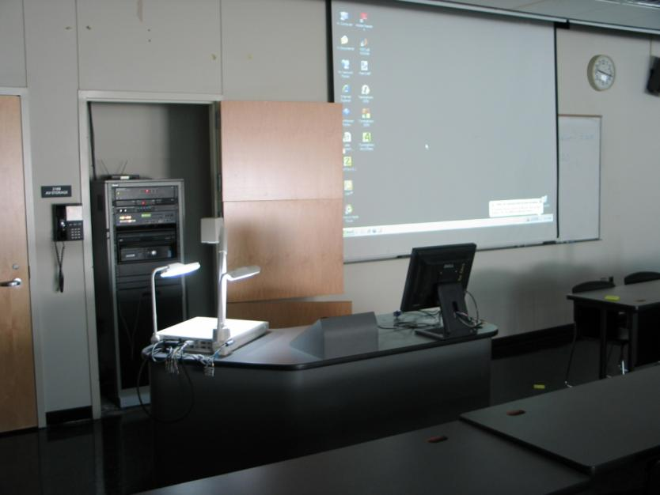
The Levels: Level 3
LEVEL 3 has everything in a level 2 (note the system 7 in the closet), but also includes a AMX Touch Panel, with microphones placed in room per faculty request

Slide 12
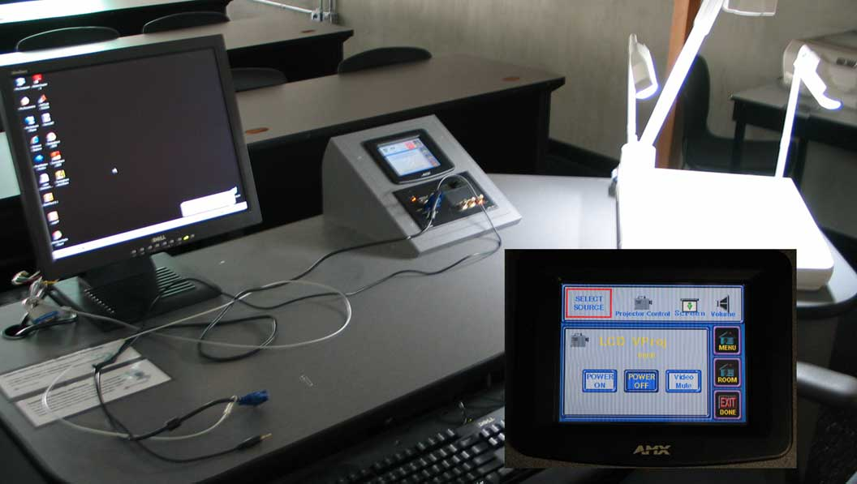
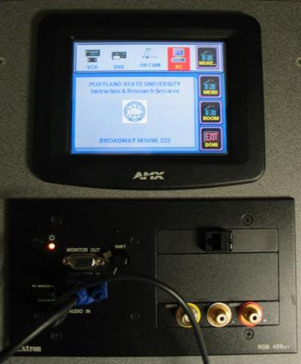
The Levels: Level 3 continued
group.
Extron System
7 SC with AMX:
Faculty,
”Why can’t I
just use the
System 7?”
It was confusing.

Slide 13
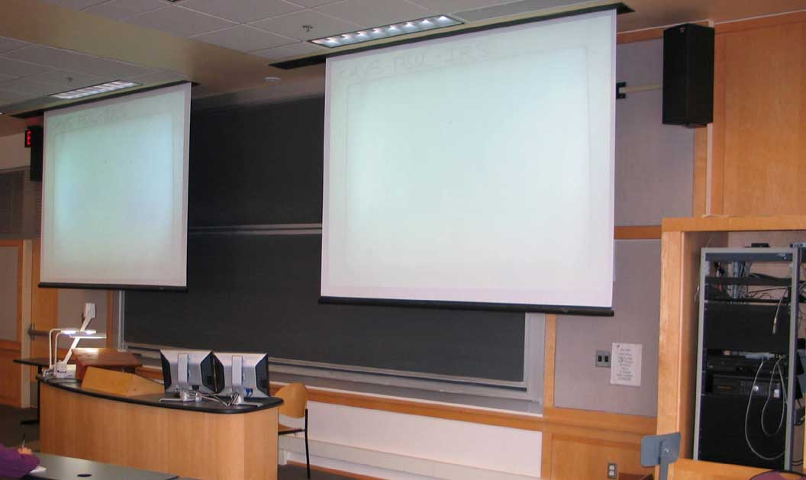
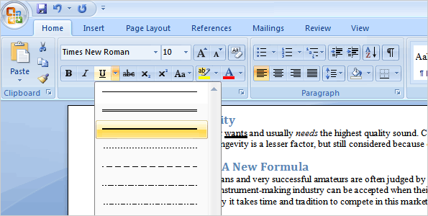
The Levels: Level 4
Multiple-Image classrooms all with AMX touch screen controls.
Some had Extron System 7s; Some did not.
The new editing method:
Now you can see a live preview of your choice before you make a selection, which saves you time and gives you better results.

Slide 14
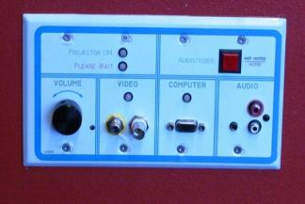
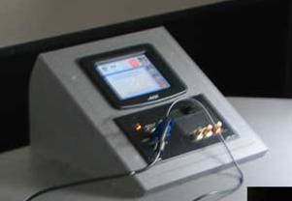
What were the issues?
Different modes of controlling and operating equipment, some automated, some manual. Faculty never felt confident.
Different projectors with unique throws, lamps, and lumens
Different equipment available (e.g. doc cameras) in each room, making it difficult for faculty to adopt technology tools.

Slide 15
How Many Projectors?
In 2005, Portland State had the following projectors installed in general pool classrooms:
NEC VT 540, NEC MT 1040, NEC MT 1050, NEC MT 1060, Hitachi 345, Hitachi 445, Hitachi 605, Hitachi 880 Hitachi 1230, Hitachi 1250, Proximas and Sonys.
AN INVENTORY AND STOCKPILING NIGHTMARE!
Lots of $$$ to keep every lamp in stock, many just sitting collecting dust.
Related Support and Triage Issues?
Projector mounts at different distances to fill screens, different controls, inputs, functionality lamp life and lumens, locations of projector mounts, power and pathways led to additional Facilities costs (mount relocation) and hot swap restrictions.

Slide 16
Section 2
STANDARDIZING:
What should you standardize on?
When it does/doesn’t matter?
Why standardize on anything?

Slide 17
Standardizing: What? When? Why?
CONTROL SYSTEMS
-Is it scalable? Is there a version that will work both in situations where budget limited and when it is not?
-It is flexible enough for future upgrades?
-Is it easy to use and dependable?
Same brand = safe? Not Always
Example: Extron System 7 SC vs. Extron 5 IP
Notes:
The Microsoft Office Button takes the place of the File menu in several Office programs. It provides more options, more conveniently located together.
In this lesson you’ll also find out what to do if you can’t find a command you need, see how to work with the new file formats, and find out how people who haven’t upgraded to Word, Excel, or PowerPoint 2007 can open your files and work in them as usual.

Slide 18
Extron vs. Extron in Standardization Issues
Extron System 5 IP: turn/off on the projector with a quick press
Extron System 7 SC : turn on/off the projector by pressing
and holding button for two seconds

Slide 19
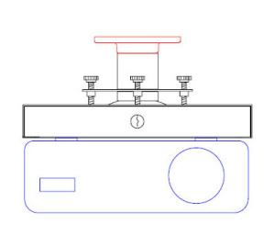
How or Why standardize Projectors?
If you cannot standardize on single model, standardizing in sub sets based on room size, projector throw, and functionality (e.g. closed captioning enabled, resolution, available inputs) is the next best option for being prepared for hot swapping, upgrading, and even things like lamp inventory.
Some manufactures will have lamps that work in a wide range of models. (For PSU, Panasonic projectors have worked out quite well.)
Standardize on projector mounts? Yes!
For PSU, BMS universal security mounts have worked regardless of projector model or type and allow us to carry just a few keys yet still readily swap or triage projectors

Slide 20
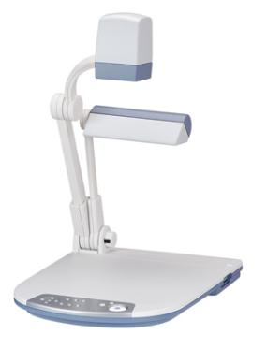
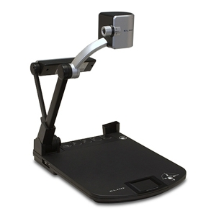
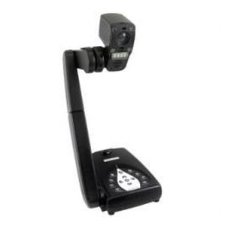
Document Cameras
This has been the hardest item for PSU to standardize on, as it seems the technology has rapidly evolved in the last several years.
Is there one that meets a variety of needs?
Is it cost effective enough that you can standardize on it and replace existing installed document cameras?
How hard is it for faculty to adjust from one document camera to another?

Slide 21
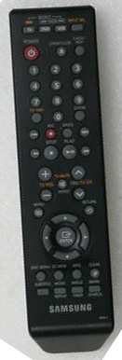
DVD/VHS Combo Players?
It appears that what matters most is that the remotes all have similar layouts, features and functions. Changing remotes or when they alter the nomenclature from having “Main Menu” to “Top Menu” has caused confusion. Also, if a manufacturer updates their player, sometimes their remotes change, making swapping difficult and triage challenges. (ex: Panasonic vs. Panasonic.)

Slide 22
Screens? Speakers?
Screens: (AR) Like most of you, we are in transition from 4 x 3 screens to 16 x 10 screens. The mixture on campus does not appear to be an issues for faculty, and our projectors are able to alternate between the ratios. Electric vs. Non-Electric depends entirely on size of screen. Our faculty seem to get that if it is a LARGE screen, there is a screen control on the wall labeled as such. We keep screen controls off the podiums for the ability to swap an entire podium if needed.
Speakers: Because this is not an item faculty touches, we have felt free to purchase whatever we have wanted without any apparent negative repercussions. (We’ve standardized to JBL and Toa speakers for our ease of use, set up and support, but not because of faculty need or request.)

Slide 23
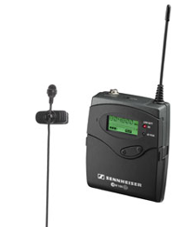
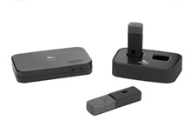
Microphones/Audio Reinforcement?
This is one area where PSU is still working on an ideal solution, which still seems to evade us.
PSU has both Sennheiser and Revolab microphones. While there have been some issues, they have been on the triage support side and not particularly related to faculty training.

Slide 24
Section 3
Lessons Learned: PSU Technology Classrooms

Slide 25
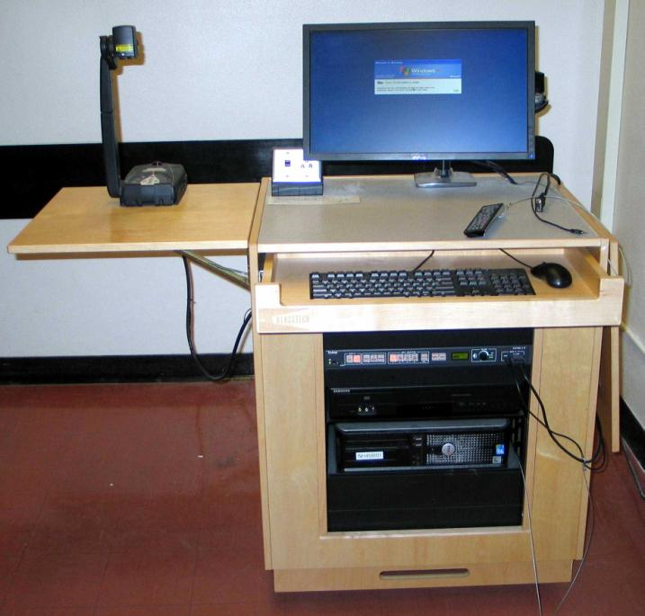
Instructor Stations and Furniture
Faculty seem more at ease with the resident technology now that the majority of the classrooms all appear identical, even when there are modest differences in instructors stations with items like document cameras and DVD/VHS combo players.

Slide 26
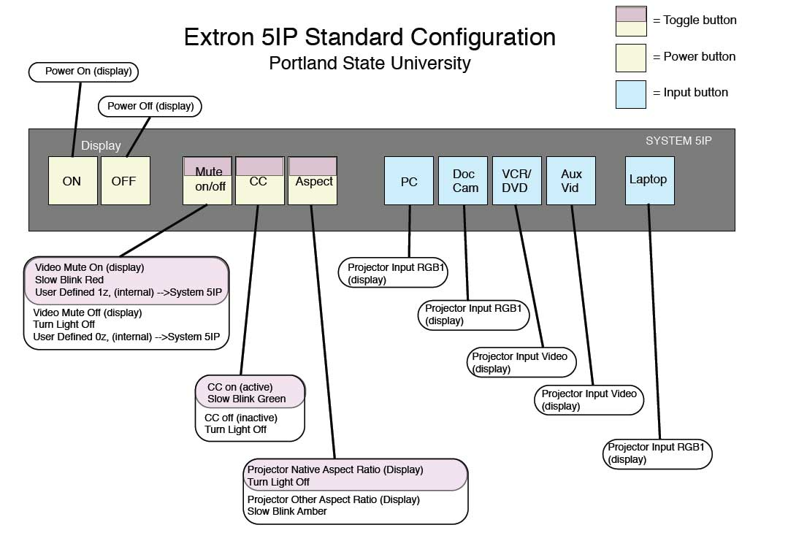
Wiring and Programming?
We’ve moved to RS 232 controls from a mixture of IR and RS 232 for control systems and projectors
We program most of our Extron System 5 IP switchers to a uniform standard.

Slide 27
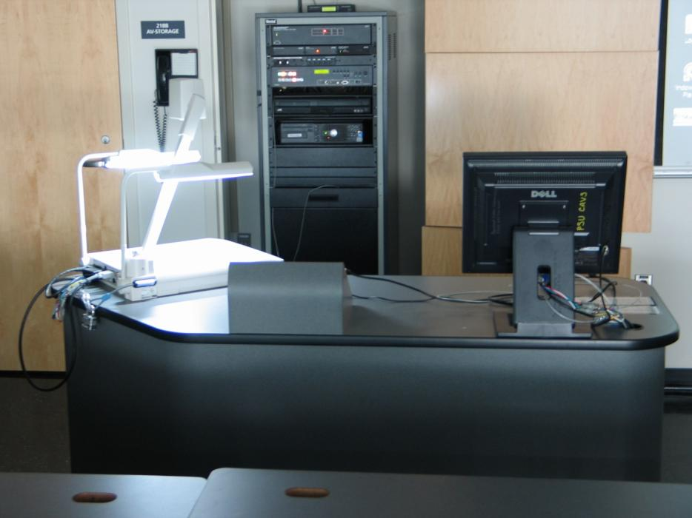
Eradication of Variation: Ondine 218
ONDINE 218
BEFORE

Slide 28
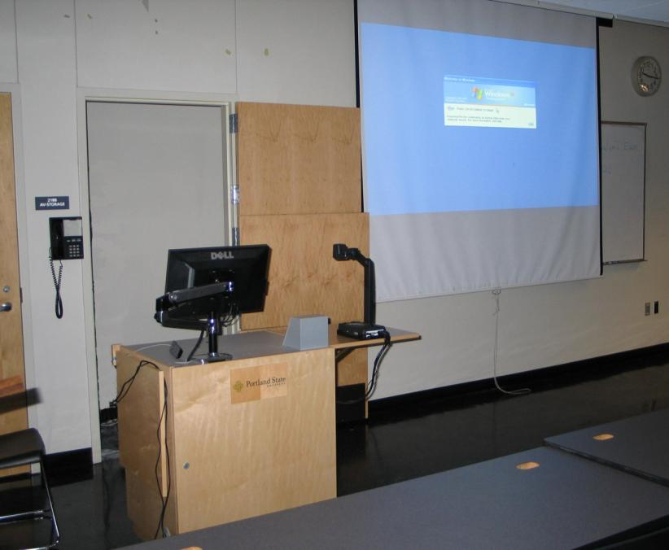
Ondine 218
ONDINE 218
AFTER

Slide 29
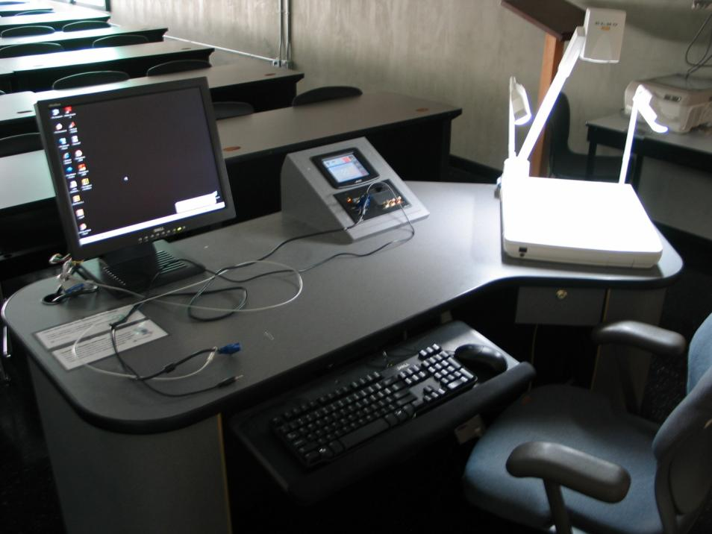
Ondine 218
ONDINE 218
BEFORE

Slide 30
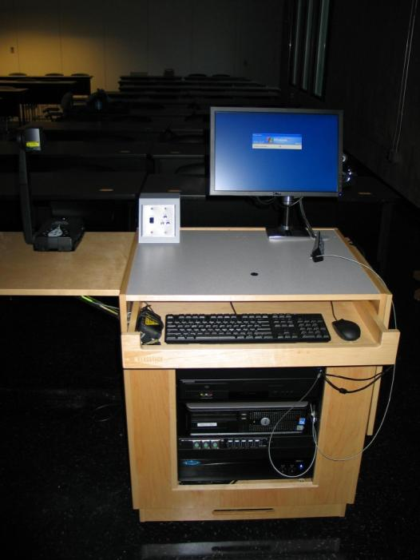
Ondine 218
ONDINE 218
AFTER

Slide 31
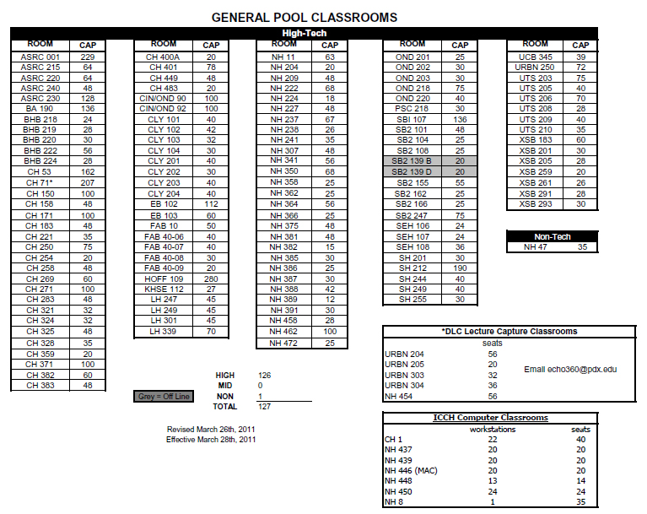
PSU Technology Classrooms (circa 2011)
3 AMX controlled multi-screen classrooms (There used to be 14 w/AMX.)
7 Extron System 7 SC
116 Extron System 5 IP classrooms
Most are in Klasstech podiums.
Faculty training is down

Slide 32
Standardizing Based on Classroom Size
Up to 45 Seats = Klasstech Professional, Extron System 5 IP, Panasonic FW 300, Dell PC, AVerMedia Document Camera, Samsung DVD/VHS Combo Player, with buttons programmed for “Aspect,” “Closed Captioning,” and “Mute.”
45 to 90 Seats = Klasstech Professional, Extron System 5 IP, Panasonic FW 300 or possibly more powerful projector, Dell PC, AVerMedia Document Camera, Samsung DVD/VHS Combo Player, with buttons programmed for “Aspect,” “Closed Captioning,” and “Mute,” with a PA system with RevoLab microphones.
90 plus seats = Some customization, including higher resolution, brighter projector, and possible Extron or AMX touch panel, but ONLY if the room has simultaneous, multi-source utilization options while also allowing for single source use.

Slide 33
What About Working With Departments?
By standardizing on equipment already in use on campus, we can better support departments. For departments on a budget, help them find a scalable solution or version of the technology in the classrooms.
Even if they have unique needs, work with them on input options and standards for, at a minimum, the control or switching system.
Sell them on the benefits of purchasing equipment that you already support on campus, allowing you to better support their equipment, including lamp replacement, servicing and even remote management of their classroom via a product like Global Viewer Enterprise (GVE).

Slide 34
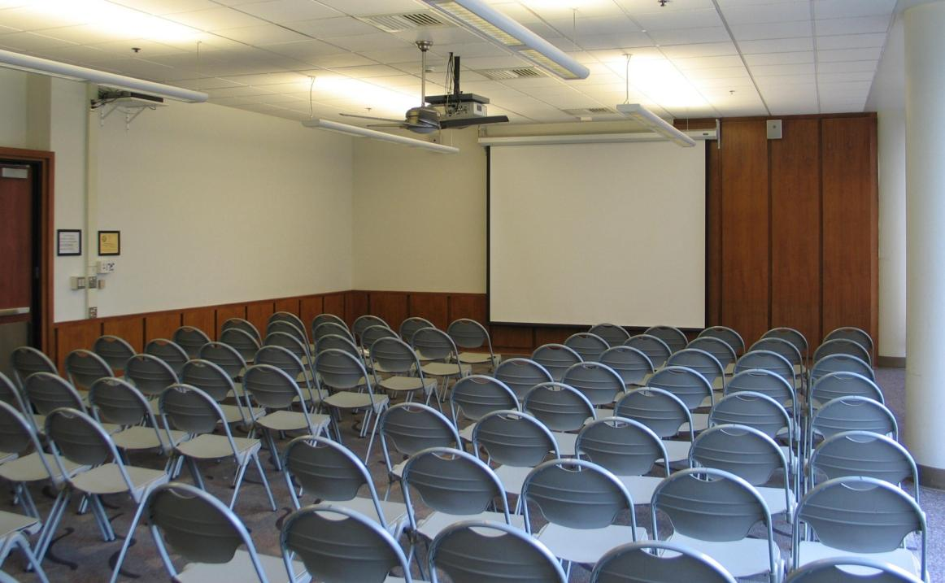
What About Working With Departments?
Conferencing and Events now has Extron MLCs, making it easy for faculty and clients using multiple locations across campus during their events.

Slide 35
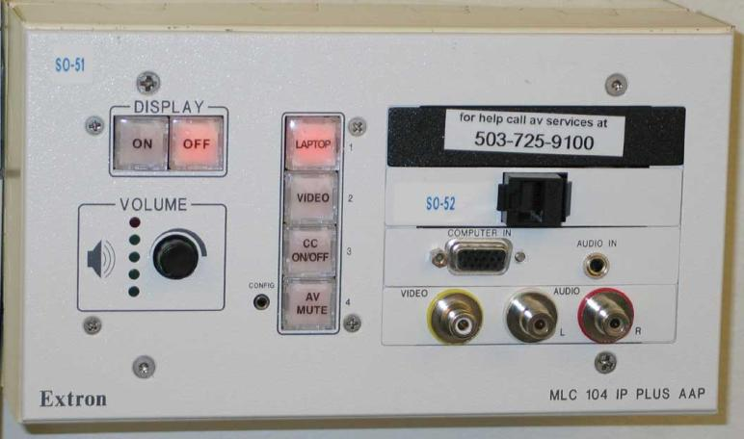
Extron MLC 104 IP vs. 5IP: Better!
Remember the question of scalability?
Extron MLC 104 replaces the Mid-Tech as the low cost alternative for limited budget projects
Buttons operate the same as on the System 5 IP, so faculty can go from their departmental spaces to general pool spaces and still know how to operate the equipment

Slide 36
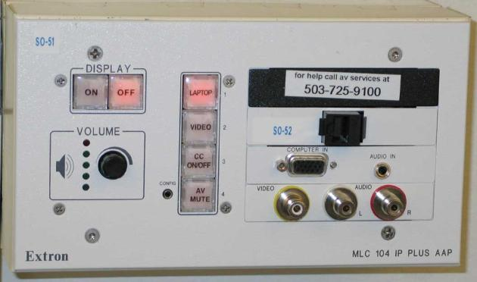
Extron MLC 104 IP vs. System 5IP
Faculty can move from a full high-tech (Extron 5 IP) to an Extron Media Link Controller (MLC) 104 with ease (compared to the mid-tech) because the buttons operate in the same manner.

Slide 37
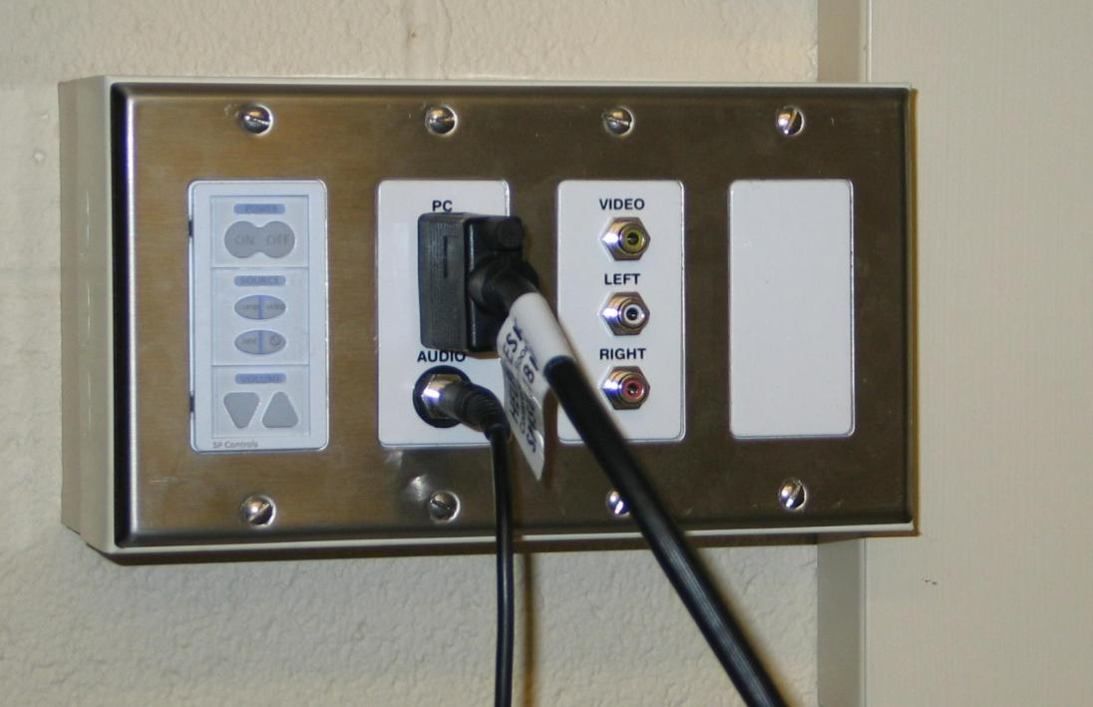
Computer Labs & Classrooms?
For computer labs and classrooms, we used to advise clients install Pixie Sytstems, but now that fails our standardization goals, so…

Slide 38
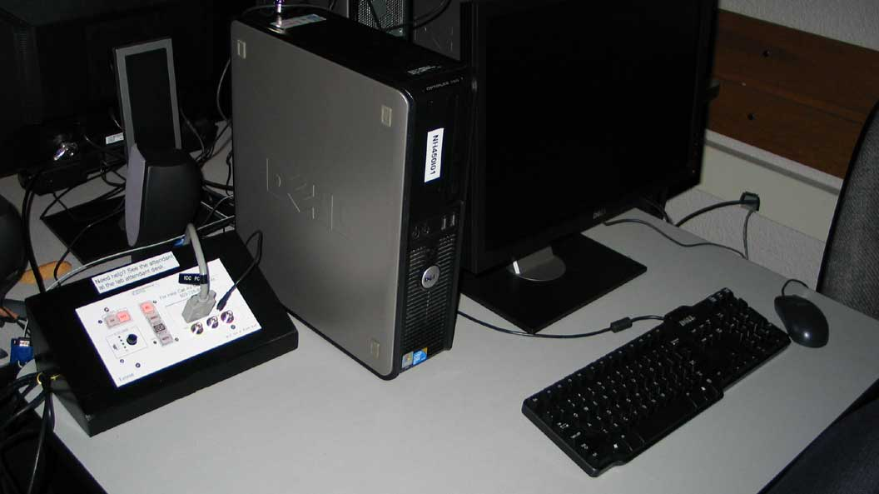
Computer Labs & Classrooms
We have installed Extron MLC 104 systems in the computer labs, too!

Slide 39
Section 4
On-Going Challenges

Slide 40
On-Going and Upcoming Challenges
Standardizing 126 classrooms and on-going updates
Document Cameras
Short Throw Projectors
Moving to a new standard of High-Def capable systems
iWhatever compatibility and connectivity issues
Types of inputs should be readily available: Display Port, HDMI, DVI, VGA, RCA…

Slide 41
Questions

Slide 42
Thank you for your time and attention!

