Slide 1
Evaluating Your A/V: From Idea to the Finished System
Gary P. Malick CTS-D, CTS-I CQD,CQT
Manager of Audio Visual Technologies
Western Washington University

Slide 4
Problems we see today;
EDID mismanagement (no EDID plan)
HDCP issues
Audio- poorly designed , intelligibility issues
TED -total equipment data base (are you getting one)
Notes:
Define edid, Extended display identification data (EDID) is a data structure provided by a digital display to describe its capabilities to a video source
HDCP definition High-bandwidth Digital Content Protection (HDCP), is a form of digital copy protection developed by Intel Corporation[1] to prevent copying of digital audio and video content as it travels across connections. Types of connections include DisplayPort (DP), Digital Visual Interface (DVI), and High-Definition Multimedia Interface (HDMI),

Slide 5
Poor Quality !!
Notes:
Video intro

Slide 6
The Costs of Poor Quality
Time wasted in diagnosis and repair, AV Technician
Time wasted in corrective actions by AV supervisor
Expedited shipping costs to get the right part in
Travel costs for recalls and ‘service’
Time wasted due to improper labeling (can your techs fix what the AV integrator installed)
Time wasted in meetings with disgruntled faculty
Time wasted in hunting down information (passwords, IP addresses, etc.)
Costs of redesign and rework
Never ending punchlist
Rooms down, not fully functional
…the list goes on!
Notes:
Costs are HIDDEN – its all in hours. Management is oftentimes totally unaware. We hand this out at the cqt and cqd training sessions as part of their materials, many items related to AV integrators , contractors ect..

Slide 7
What You Need To Walk Away With
There is a Standard for AV Implementation that WORKS!
It has been applied successful in thousands of installations, and keeps improving
It can dramatically simplify AV Engineered Systems procurement
Notes:
These days you guys are lucky.

Slide 8
AQAV
Mario vid
Notes:
Pass out the standards

Slide 9
What is Quality?
“Conformance to requirements”
Making sure they fulfilled their end of the bargain with you- the customer
Notes:
Here’s how we are defining it for now. No glitter. No luxury, just delivered what was ordered, without the defects.
Also mention that AV9000 is the MINIMUM a customer expects. There is ample room to address the special sauce of a vendor to differentiate from other companies. Think of the Apple Computing experience, and how far away we are from achieving that user experience for our AV systems.

Slide 10
What is Quality ??
“Quality is fitness for use” – Juran
“Quality means conformance, not elegance” –
Crosby
“The first erroneous assumption is that quality
has something to do with goodness, or luxury, or
shininess, or weight”. – Crosby
“Quality, “Economy of Effort”, and Profits are
different pronunciations of the same word.” –
Maltese
QUALITY = CONFORMANCE TO REQUIREMENTS!
Notes:
Philip Bayard "Phil" Crosby, (June 18, 1926 – August 18, 2001) was a businessman and author who contributed to management theory and quality management practices.[4] Zero defects concept
Joseph Moses Juran was a Romanian-born American engineer and management consultant. He is principally remembered as an evangelist for quality and quality management, having written several influential books on those subjects.[
SO how do we confirm conformance and set the requirements BE clear on what the REQUIREMENTS are! We can have it in a basic utilitarian system

Slide 11
AV system Plan stages
Design stage
Staging
Commissioning
Notes:
Use of check list in each of these stages, also mention the program phase, show the black book

Slide 12
Notes:
This is what we see in perhaps assembly line , at the end some test it ( we hope) then its go or no go, throw it in a bin, do we see this in AV , think of the PC board example from manufacturing

Slide 13
Notes:
Checking all along the way, design stage, is that ALL IMPORTANT NARRATIVE TRULLY , ACURATELY DEVINE WHAT YOU WANT!
Staging, do you contractors do this actually test configure, figure out things in their shop ( staging area) then that final stage or almost final, when it is commissioned the commissioner can pick up that narrative and see if the system is performing the way it was designed. Says here a spot for a laptop with both VGA and HDMi, don’t see one for HDMI . Ect…. But that would be caught way back at design review

Slide 14
Problem areas
EDID
HDCP
Audio
TED

Slide 15
EDID woes
Extended Display Identification Data
Designers don’t address EDID
Install techs don’t know what is needed, just go with default settings?? How is it set?
Finished systems , commissioner does not know what the intentions are for performance
Notes:
Lets review what is EDID, describe the simple system

Slide 16
To the Point: Have a EDID plan!
Address it at each stage

Slide 17
DESIGN Stage:
An EDID Plan has been prepared and included in the design package in some form. The plan must include intended resolutions at each display, and required image settings when there are aspect ratio mis-matches. The Plan indicates how each device in the video chain (especially sources) gets its EDID information and configuration information (including supported resolutions, refresh rates, HDCP support and audio format information) in an unambiguous way so that the AV specialists can easily configure the system as designed. The required resolutions at the displays take visual acuity into consideration in accordance with the intended use of the system and distance to the furthest viewer.
Notes:
Look for notes , references , callouts , software needed , can’
T ignore this

Slide 18
Staging Time (if applicable)
The system has been configured in accordance with the designer’s EDID Plan, where applicable, and the system performs as intended (resolutions, displayed images, audio formats, etc.
Do the techs have the needed software , manuals
Test instruments, ( do they have the plan), know the designers intentions??

Slide 19
Commissioning
Repeat from staging:
The system has been configured in accordance with the client’s EDID needs, and the designer’s EDID Plan, where applicable, and that the system performs as intended (resolutions, displayed images, audio formats, etc.)
But now we kick the tires:
Play the intended resolutions, audio formats Refer to commissioning list 6.3
Notes:
Recall way back at the design or programming phase; what did I want to happen, I wanted my laptop to know it was connected to a Epson model such and gave the ability to choose both its native but also my favorite 1280/ 800 ect.. Go back to the design docs did we get it right

Slide 20
HDCP- High-bandwidth Digital Content Protection
-Design for it
-Test for it
If any device in the chain is not HDCP compliant, the video stream will fail.
Notes:
Note same area of design review as edid

Slide 21
The system is meant to stop HDCP-encrypted content from being played on unauthorized devices or devices which have been modified to copy HDCP content. Before sending data, a transmitting device checks that the receiver is authorized to receive it. If so, the transmitter encrypts the data to prevent eavesdropping as it flows to the receiver.

Slide 22
Notes:
What you don’t want to see

Slide 23
In order to make a device that plays HDCP-enabled work, the manufacturer must obtain a license for the patent from Intel subsidiary Digital Content Protection LLC, pay an annual fee, and submit to various conditions. For example, the device cannot be designed to copy; it must "frustrate attempts to defeat the content protection requirements" it must not transmit high definition protected video to non-HDCP receivers; and DVD-Audio works can be played only at CD-audio quality[7] by non-HDCP digital audio outputs (analog audio outputs have no quality limits).
Notes:
Where quality products matter, paying for that license , and note the audio remarks

Slide 24
Staging an Commissioning Test:
All HDCP sources can be routed to all expected destinations at the same time. There are some devices with a limited capability to display on multiple displays. The system requires that each source can display on the required number of displays in the system at the same time.
All sources can be routed to all expected destinations. Disregard any routes that are not permitted by design, as described in the narrative, such as HDCP sources routed to a codec.

Slide 25
A BluRay movie plays. Sometimes HDCP is not enabled during the menus and previews, but only during the movie. BluRay disc required.
Notes:
Note delays, try several discs

Slide 26
Audio

Slide 27
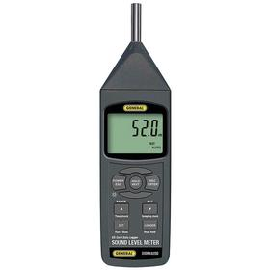
Know what you are starting with: Anticipated ambient noise level
Measured at various times in db-SPL-A wtd
Notes:
Typical readings: 35 quiet conference room, 40 board room, why times: air handling, outside noise, adjoining rooms, foot traffic ect…

Slide 28
Microphones
Microphones are properly placed.
Microphone patterns are carefully chosen.
Wireless microphones: spectrum issues
Do you need a sweep
Ceiling mics ??
NOM -gain before feedback rule
Distance rule
Notes:
Compare to room drawings, define the rules , ceiling mic woes

Slide 29
Stability
The rooms that are just never right
Need to do the math
Nag: Needed Acoustic Gain
Pag : Potential Acoustic Gain,

Slide 30
PAG
the maximum amount of gain a system is capable of producing before causing feedback.

Slide 31
NAG
Needed Acoustic Gain, or the amount of gain required for the farthest listener from the audio source to hear as well as the nearest listener.

Slide 32
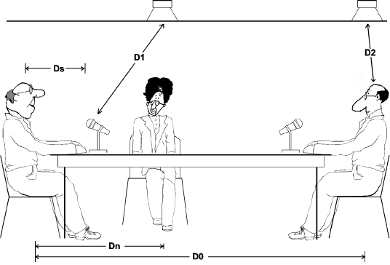
Notes:
Idea you talk at level for the closet person

Slide 33
If PAG is greater than NAG, a system will operate without feedback; if PAG is less than NAG, a system will suffer from feedback before providing an optimal listening experience.
Notes:
Make sure the needs are less than the potential

Slide 34
Pag Equation
PAG=20logD1 –20logD2 +20logD0 –20logDS –10logNOM-6
Or just go to: http://www.shure.com/americas/pagnag
Also see Lectrosonics YouTube video on same
Notes:
Do the math on the buggers , referred to in the standard way back at design, if you think you will be dealing with a Un stable system catch when you can do something about it

Slide 35
Matching
Loudspeakers and power amplifiers driving them are impedance compatible
There is a method of leveling source inputs, so that the audio level in the room does not change in level when a new program source is selected.
Notes:
Note on confirming speaker setting 70 volt JBL story, where the check list comes in, hanging speakers might be given to the new guy

Slide 36
Watch out for the magic
Balanced to unbalanced and vice versa
How is it happening
Details
HDMI audio (is a de-embedder needed)
Notes:
Wireless microphone receiver to a PC usb pre or DVD player DI boxes, system needing analog, have to strip it out

Slide 37
USB preamps

Slide 38
Wireless microphone details
Batteries chargers, where , what type will battery charge indicator work
Where will it live, security concerns

Slide 39
More wireless concerns
Wireless microphone systems, with all wireless microphones turned on, there are no dropouts, intermodulation interaction between wireless systems, or RF caused artifacts throughout the specified operating area for the transmitter. There is little or no RF activity on a receiver’s “S” meter when the designated microphone transmitter is off.
Notes:
Very very important, good to catch this in Staging, not trying to fix at commission time Extron switcher story

Slide 40
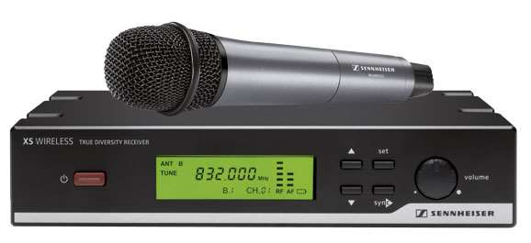
Notes:
Discuss noise from digital switchers

Slide 41
STI-PA
STI is a numeric representation measure of communication channel characteristics whose value varies from 0 = bad to 1 = excellent.[5] On this scale, an STI of at least .5 is desirable for most applications.
Notes:
Required in many jurisdictions where system is used for emergency messages, think fire alarms, over all good eval of your systems, especially the buggers

Slide 42
STIPA example
stipa test
Notes:
Suggest youtube video Sound system intellgibility soul sound

Slide 43
Great tools
Notes:
Check NTIs STIPA video

Slide 44
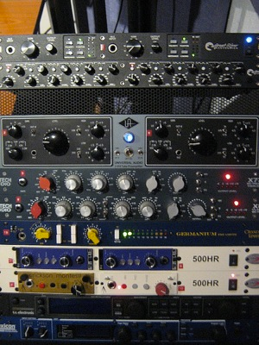
DSP-Digital Signal Processors
What one rack unit can do:
Notes:
What you get in this box: limiters , compressors, parametric equalizers, preamps

Slide 45
Today and the future
Notes:
What software was used to program this, passwords , filters, how were these determined, best practice with SYNAUDCON is to EQ or filter to the speakers frequency response curve, not try to fight room problems , whwre is your listening spot

Slide 46
Notes:
Pat and Brenda Brown, excellent training opportunities: core principals of audio, sound system tech, sound system designer, , making wireless work, Opt EQ opt eq gets in deep to these filter and eq settings

Slide 47
Back to the Nexia DSP box
• Ability to select, view, and calibrate:
Mixers: standard, automatic, matrix, combiners
Equalizers: graphic parametric, feedback
Filters: HPF, LPF, high shelf, low shelf, all-pass
Crossovers: 2-Way, 3-Way and 4-Way
Dynamics: leveler, comp/limiter, ducker, ANC
Routers: 2x1 ~ 32x32
Delays: 0 ~ 2000ms
Controls: levels, presets, logic, RS-232, etc.
Meters: signal present, peak, RMS
Generators: tone, pink-noise, white-noise
Diagnostics: transfer function
Notes:
lots to get set wrong-Bottom line you need to know what was set why and how, how will you be able to make changes in the future. Move to ted

Slide 48
TED
TED -total equipment data base (are you getting one)
Notes:
Back in the day you were happy to get the make model and serial number move to view the Ted tab at commission checklitst high light Firmware, version, programs used version, warranty ect.. Transition to the checklist

Slide 49
Transistion to AQAV excel

Slide 50
LEAD WITH QUALITY!!!
aqav.org
mmaltese@aqav.org
Thank you!

