Slide 1
NW/MET Conference
ELECTRONIC WASTE POLICIES AT OSU AND HOW TO DISPOSE OF EQUIPMENT

Slide 2





Who we Are:
Rae DeLay: Materials Manager
Steve Schofield: Warehouse
Bil Burton: Equipment Specialist
Tom Radel: Online Sales
Miranda Cooley: Receiving

Slide 3


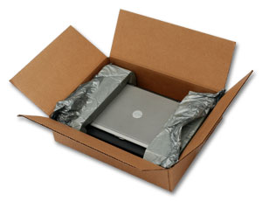
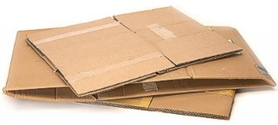
Things to consider when buying.
How is it packed?
  Campus Recycling collects from departments over a truck load of Polystyrene a month
  Recycling has found a vendor (Agilyx) that will process the Polystyrene into raw materials to produce more Polystyrene. http://www.agilyx.com/
Request the Computers and Monitors to be packed with cardboard corners.
Request extra recycling containers for large shipments.
  Cardboard Containers at building are emptied once a week.

Slide 4
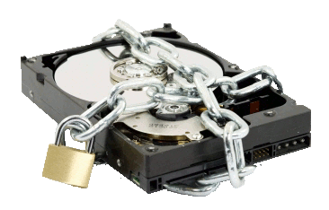
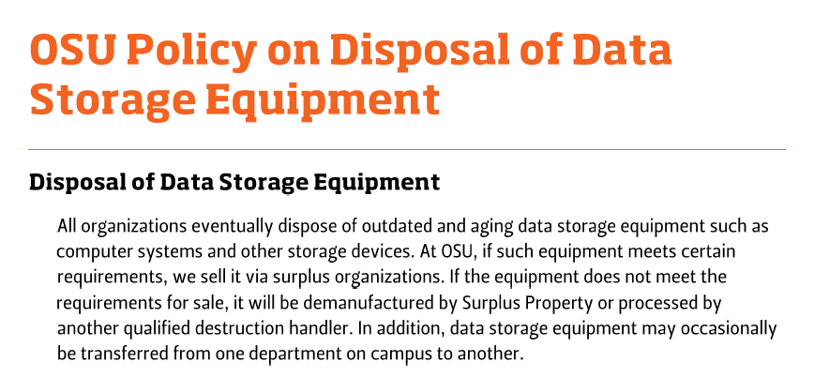
Data Security

Slide 5

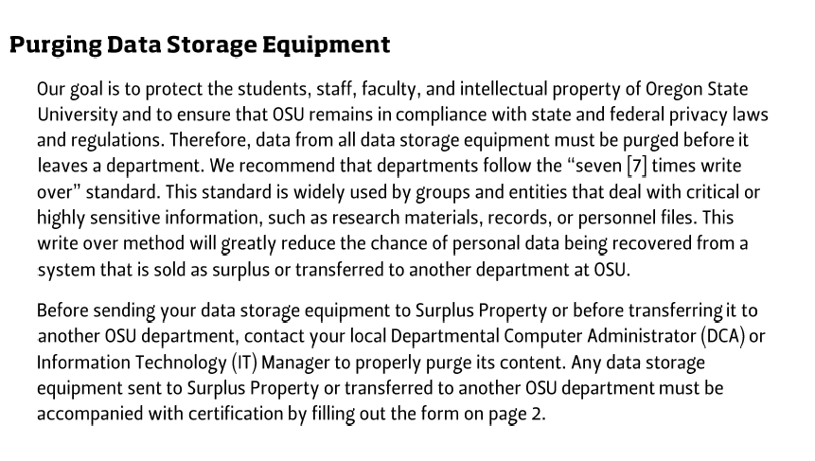
Purging Data

Slide 6

Surplus receives and determines disposition
Questions?
Has the drive been cleaned of OSU data?
Is the computer resalable?
Options:
Resale at OSUsed Store
Resale Online
Donate to local schools/non-profits
E-waste

Slide 7
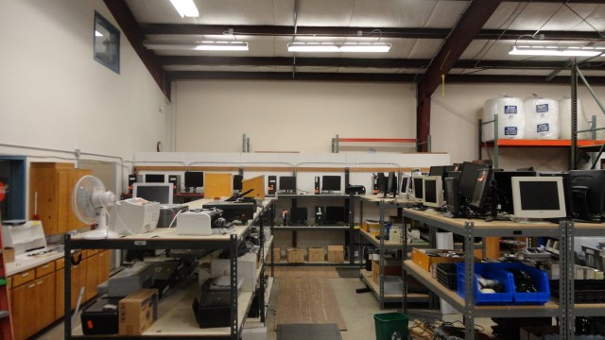
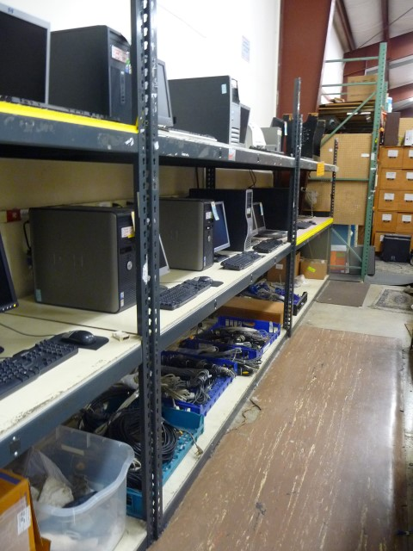
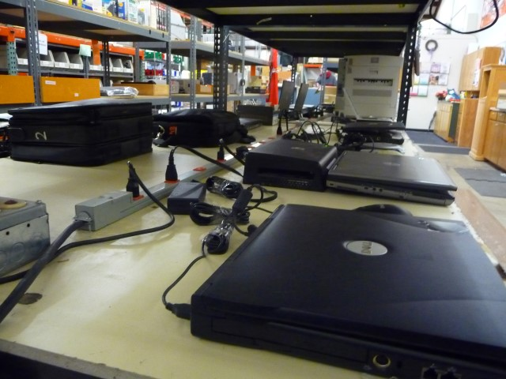

Resale -

Slide 8
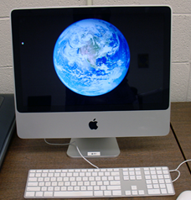
OSUsed Store
OPEN to the Public Tues. 5:30-7:30pm & Fri. 12-3pm
Doubled the sales hours in 2016.
FY2017 Sold over $10K in cords, monitors, and misc. items from the computer area.
Average 30 Computers/Laptop a month at the OSUsed Store.
iMacs and Laptops are in higher demand.

Slide 9

Departments/Agencies
OPEN For Departments/Agencies Mon-Thurs, 8-4pm.
Must purchase with an Index. $20 Delivery fee.
OSU Departments purchase on average of 12 computers a year.
Agencies/Non-Profits purchase or receive a donation of an average of 5 computers a year.
OSU Donates on average of 20 computers to local schools a year.

Slide 10


Online Sales
FY2016 Online Computer E:\FY17 online computer.xls
Total Sales dollars: $12,361.00
26 lots of computers and IT equipment.
Utilize for lots of 10 or more units.
Have found more challenging to sell computers due to Paypal restrictions and customer support required. Sell parts only computer/laptops on Ebay

Slide 11
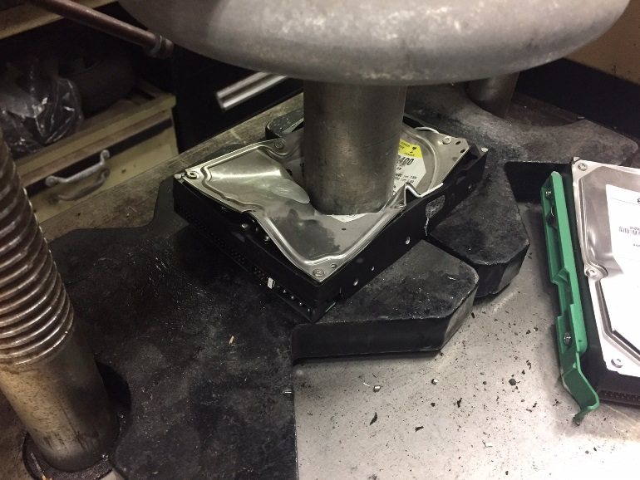
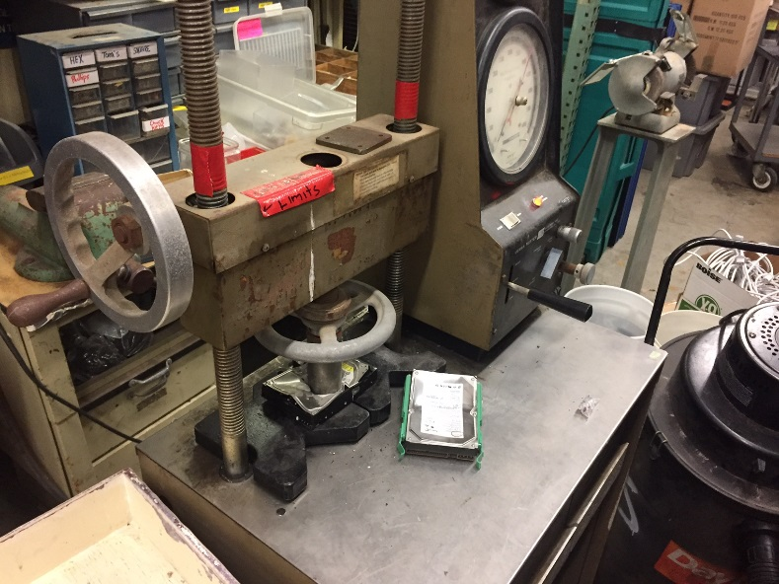
Hard Drive Destruction
Surplus will crush the hard drive prior to sending to a recycler.

Slide 12

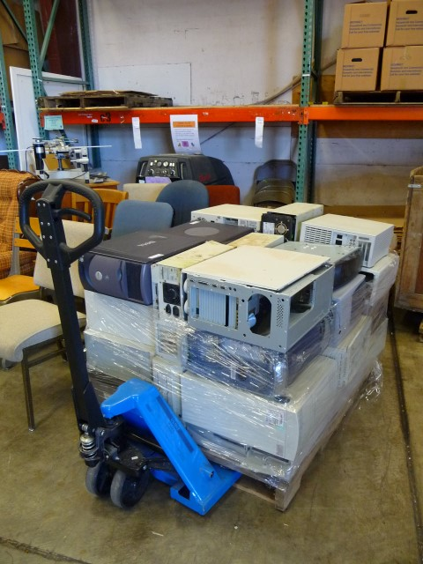
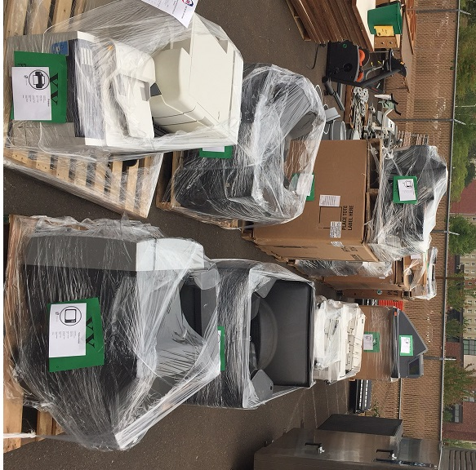
E-waste- 82,434 lbs in FY2017
50% or more of the Computers/Electronics sent to Surplus become E-waste.
1 Truck load every Month.
Received : $ 4941.00
Charged :

Slide 13



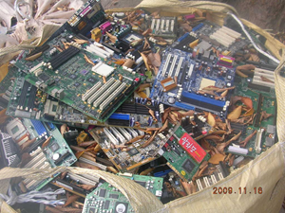
Where does the E-waste go?
After researching several vendors in the Northwest, Surplus chose to use URT. http://urtsolutions.com/
URT is E-Steward Certified and can verify where the waste is disposed or reused.
http://e-stewards.org/

Slide 14
URT – Security statement
Unlike other recyclers who outsource services to third-party vendors, our customers’ materials stay with us—we manage 100 percent of the process from start to finish. Following strict data protocols and adhering to the stringent standards of NIST, we provide customers peace-of-mind knowing their materials will not leave our secure facilities until they’re properly wiped, tested and verified as completely destroyed or refurbished

Slide 15

Recycling Market
Electronic products are rapidly becoming obsolete and are being replaced at a very short life span.
About 70% of the heavy metals in the U.S.A. landfills come from electronics, though only 2% of the trash is electronic waste.
Recyclers face challenges in finding markets for raw materials. China is no longer accepting many recyclables from other nations.

Slide 16
Summary
Recycling decisions start from the time of Purchase.
Surplus and Campus Recycling are committed to the most cost efficient disposition of materials.
Surplus is the last stop for Data Security.
Department cleans drive
Surplus verifies drive is clean
Drive is crushed or resold in a computer
URT insures data is secure
Surplus Website: http://surplus.oregonstate.edu

Slide 17
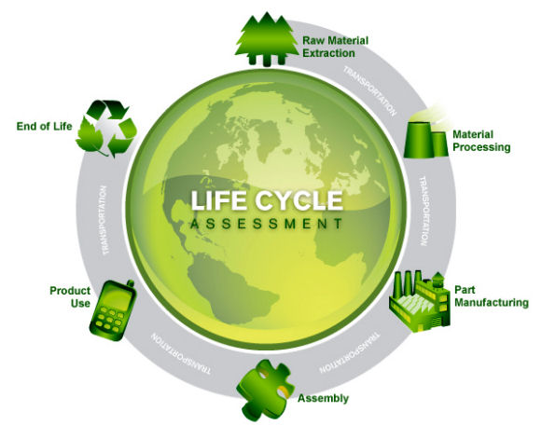
OSU is committed to Sustainability
We are all responsible for doing our part.
OSU has attained a Gold rating in STARS,
the Sustainability Tracking, Assessment & Rating System.

Slide 18
Resources available:
OSU Surplus : http://surplus.oregonstate.edu
Campus Recycling: http://fa.oregonstate.edu/recycling
STARS: https://stars.aashe.org/
  Sustainability Tracking Assessment & Rating system
AASHE: http://www.aashe.org/
  Association for the Advancement of Sustainability in Higher Education
CURC: http://curc3r.org/
  College and University Recycling Coalition
AOR: http://oregonrecyclers.org/
  Association of Oregon Recyclers
Oregon E-Cycles: http://www.oregon.gov/deq/ecycles/Pages/default.aspx
USPA: https://www.universitysurplus.org/
  University Surplus Property Association

Slide 19

Questions?

