Slide 1

Multi-Camera
Productions
& Streaming on a Budget
By Robert B. Clark
Manager, ATUS Video Services
Western Washington University

Slide 2
Overview
Types of multi-camera productions (sports, ceremonies, arts, etc.)
General equipment needs for multi-cam productions
Types of streaming (audio only, audio/video, & audio/video/data)
General equipment needs for streaming
Questions and war stories from the field

Slide 3

Western Washington University

Slide 4
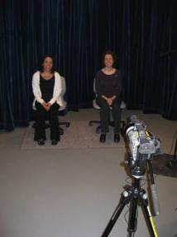
ATUS Video Services
One Staff Person (me)
7 Student Workers
15,000 Students
500 Full-time Faculty
1,200 Staff
25 productions/month
Plus duplication, video conferencing, editing,
training, lecture capture, streaming, etc.

Slide 5
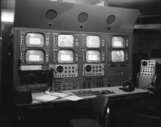
Multi-Camera (then)
Big, bulky, expensive
Often housed in a truck
Required engineer(s)
Required lengthy set-up
Did I mention “expensive?”

Slide 6
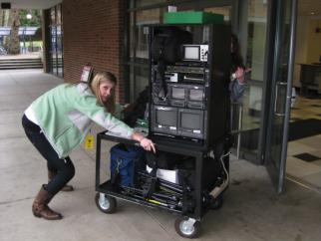
Multi-Camera (now)
Smaller, easier to use
Less expensive
More mobile
Easier to set-up
Capable of HD video
Doesn’t necessarily
require an engineer
(Can be used by student workers)

Slide 7
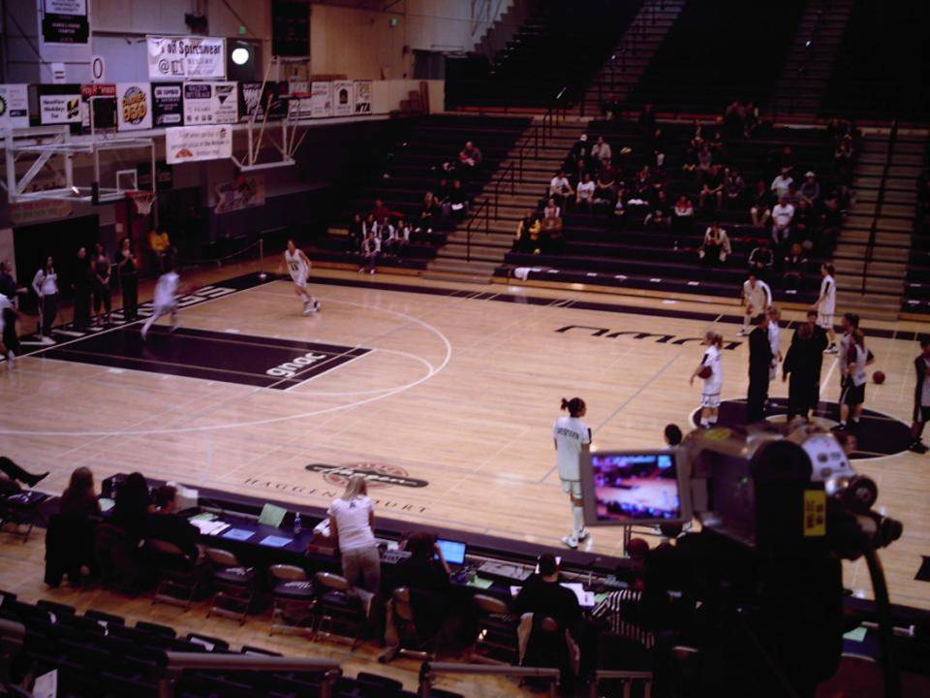
Sports

Slide 8
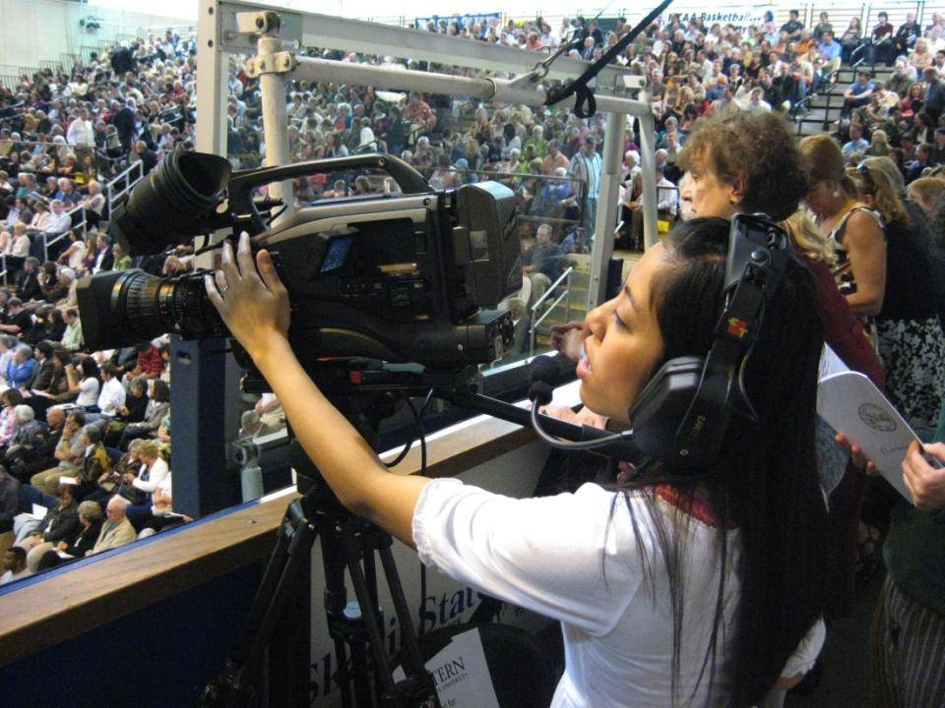
Ceremonies

Slide 9
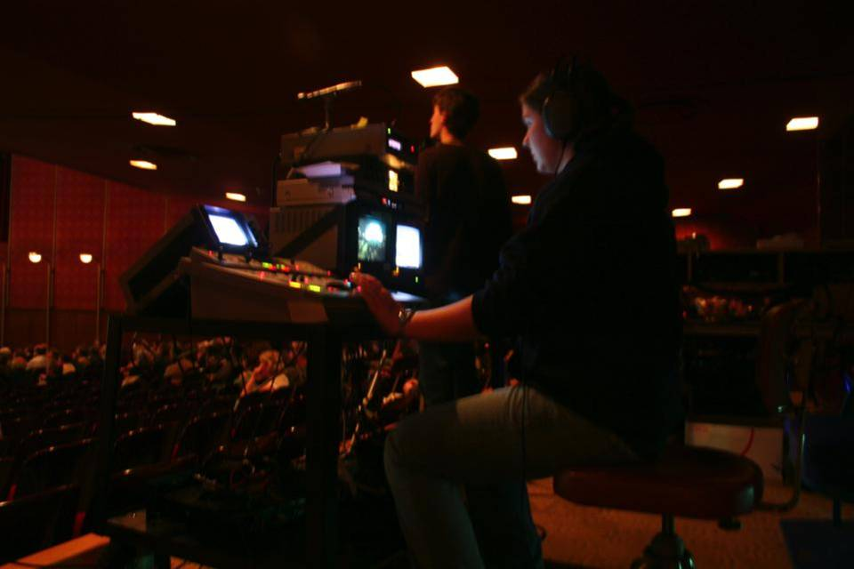
Events

Slide 10
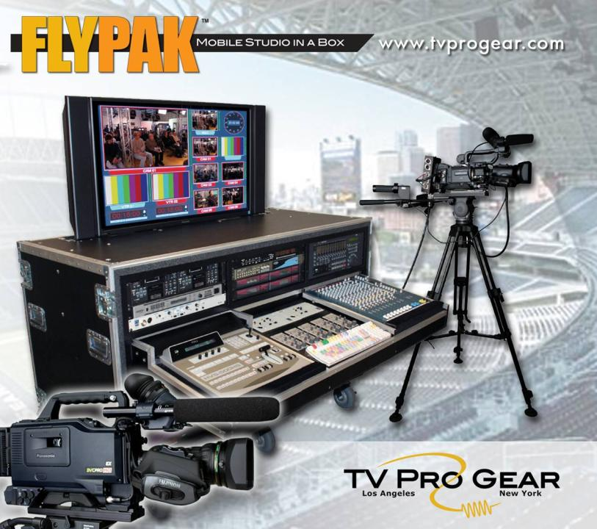

Slide 11
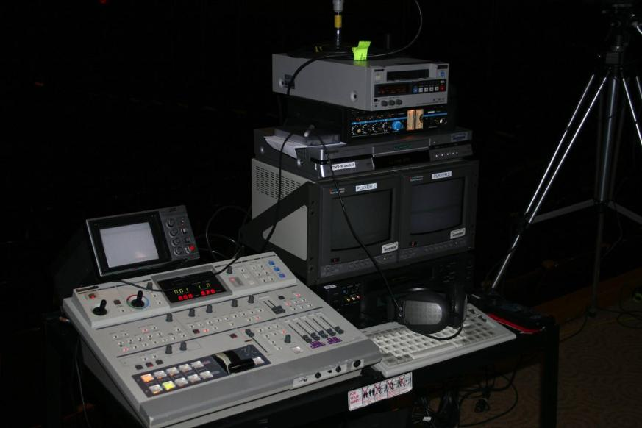

Slide 12
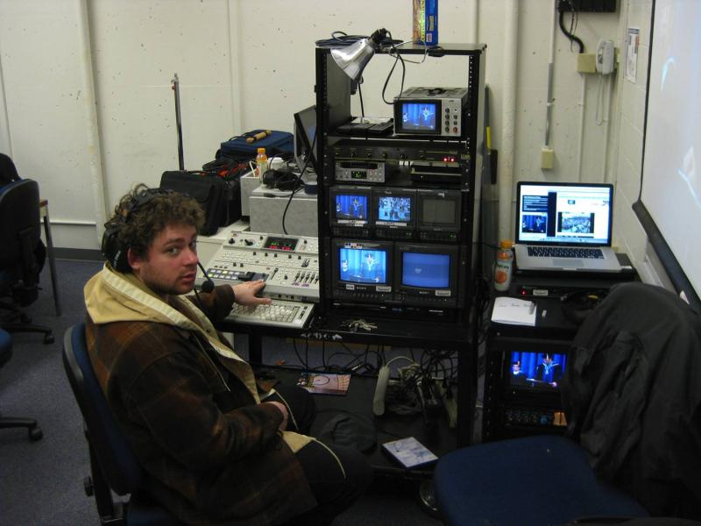

Slide 13
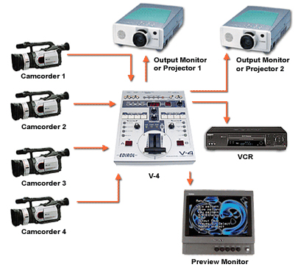
Basic Needs
Cameras
Switcher
Monitors
Recorders
Audio Mixer
DVD & Graphics
Intercom
Lots of Cables

Slide 14
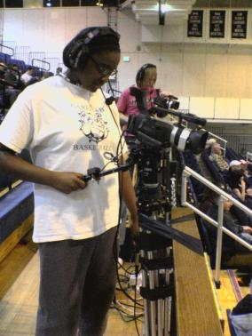
Cameras
Sturdy, 3-chip models
with manual controls
for iris, focus, awb, etc.
such as Canon GL-2 or
XL-2 or similar
preferably all the same
model so they match

Slide 15
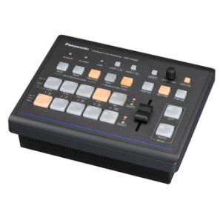
Video Switcher
Older - four inputs
with dual TBCs
and S-video/BNC
Newer – HD (such
as 1080/59.94i,
1080/50i,
1080/23.98PsF, 1080/24PsF,720/59.94p,
720/50p & SD :480/59.94i, 576/50i)

Slide 16
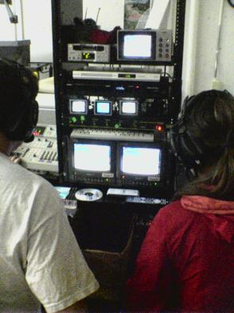
Monitors
One for each camera
One for each video input
One for the recorder
One for graphics
The bigger, the better
(but you’ll probably be
limited for space)

Slide 17
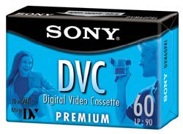

Recorders
Ideally record to
hard-drive and/or
tape for mastering
and DVD for client
preview/back-up
(Can bump up to
High-Def at this point)

Slide 18
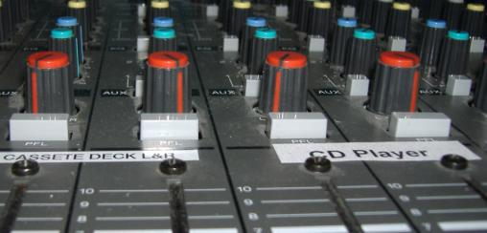
Audio Mixer
Either mic the event yourself or take a feed
from the house board (but you’ll still need
a mixer to control the house feed)

Slide 19
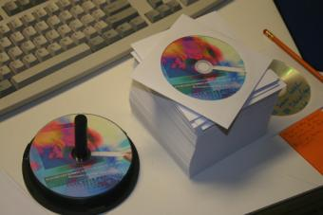
DVD Playback & Graphics
DVD Playback for
show open/close,
commercial spots,
b-roll, etc.
Graphics could be
Power Point slides
sent through a
scan converter

Slide 20
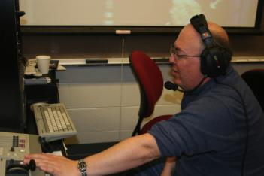
Intercom System
Wired or wireless
One set for each
camera operator,
director, etc.
Preferably with mic
kill switches for
limiting random
background noise

Slide 21
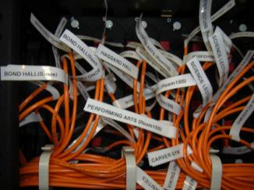
Lots of Cables
Choose the sturdiest
you can afford
Label them well at
both ends
Draw up a flow chart
of their location and
purpose
Bring extras

Slide 22
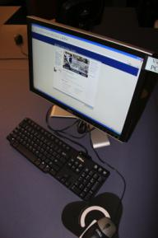
Streaming
Audio only
(such as Barix Instreamer)
Video and audio
(such as Ustream, Kyte,
Justin.tv etc.)
Video, audio, and data
(such as Elluminate)

Slide 23
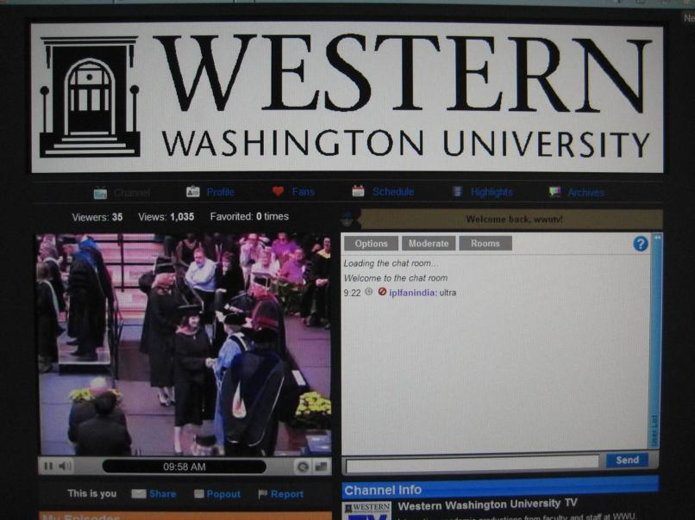
Justin.tv

Slide 24
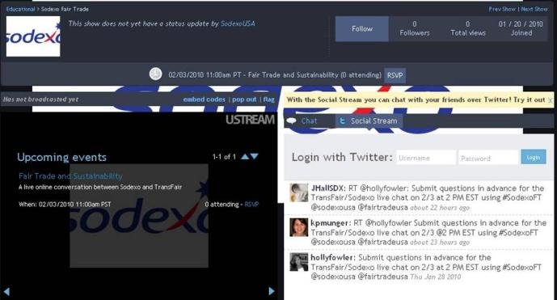
Ustream Interface

Slide 25
Various Providers
http://www.freedocast.com/
http://www.justin.tv/
http://www.livestream.com/
http://www.stickam.com/
http://www.ustream.tv/
http://www.youtube.com/live
and More!

Slide 26
Streaming Challenges
Free services often have ads
Paid services often charge by the viewer
Random chatters including spammers
Bandwidth from the production site
Quality of your stream to the viewer
Branding your page within a third party’s site
Archiving the finished product
Monitoring an additional production element

Slide 27
Questions?
Robert B. Clark
Manager, ATUS Video Services
robert.clark@wwu.edu
(360) 650-6193

